Slide 1


LEARNER’S
DIGITAL TOOLKIT
As part of the AI for Seniors Open Education Resources… A tutorial tool to empower you on your AI learning journey.

Slide 2

CONTENTS
01
Introduction
03
02
The Project
05
03
Meet the Partners
06
04
The AI for Seniors Course or OERs
09
05
Overview of the 5 Modules & Activity Sheets
13
06
Suggested Time Management
57
07
Useful Links & Resources
58
08
Glossary
59
The Finger Icon indicates a clickable link

Slide 3


01 | INTRODUCTION
AI for Seniors Learner’s Digital Toolkit
PLEASE USE THIS TOOLKIT TO CAPTURE THE KEY LEARNINGS FROM OUR BESPOKE AI for Seniors COURSE (OPEN EDUCATIONAL RESOURCES – OERs)
OUR FREE CONTENT CAN BE DOWNLOADED FROM:
https://ai4seniorsproject.eu/resources/
This Digital Toolkit follows the 5 modules of the AI for Seniors (AI4S) course in sequence.
This course aims to empower you and other older adults with clear, practical skills to understand and use Artificial Intelligence (AI) in everyday life. You will learn how to use AI and digital tools safely and how AI can support health tracking, communication with family and friends, and smart home tools that help you stay independent and connected.
The course also supports adult educators, community groups and younger mentors with simple, ready‑to‑use teaching approaches.
As you move through the modules, you will be guided step‑by‑step to build confidence, try out useful digital tools, and understand how AI fits into a changing digital world and a more inclusive Europe.
Ready to get started?
Join our online learning community of seniors, educators, community organisations and interested stakeholders across Sweden, Ireland, Denmark and Spain.
Follow our journey

Slide 4

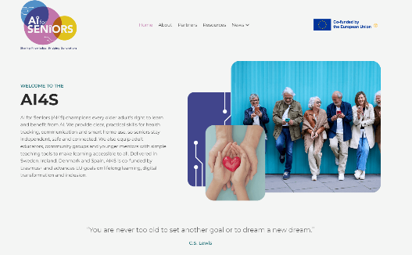
02 | THE PROJECT
AI for Seniors is an ambitious European initiative designed to strengthen digital inclusion by helping older adults understand and confidently use Artificial Intelligence (AI) in their daily lives. At its heart, the project brings together educators, community organisations and youth mentors to co‑create accessible learning pathways that make AI understandable, practical and empowering. By combining intergenerational support, real‑world testing and clear, user‑friendly resources, AI for Seniors contributes to a more digitally skilled, connected and resilient senior population across Europe.
A Mission Rooted in Inclusion
The mission of AI for Seniors is clear: to empower older adults with the confidence, skills, and digital resilience they need to thrive in an AI‑driven society. By equipping seniors, educators, and intergenerational mentors with accessible, practical, and ethically grounded AI learning resources, the project tackles one of Europe’s most urgent challenges, the widening digital divide. Therefore, the project aims to equip seniors with practical AI skills that enhance their independence, well-being & social connectivity.
This transformation is both technological and human. AI4S strengthens digital autonomy, reduces social isolation, and supports seniors in navigating everyday tasks…from communication to health management, with greater ease. By fostering collaboration between adult educators, community leaders, and younger mentors, the project builds a supportive ecosystem where seniors remain active participants in an increasingly digital world.
Vision for Lifelong, Empowered Digital Participation
AI for Seniors envisions a Europe where older adults are not left behind but are fully included in the opportunities created by artificial intelligence. The project promotes long‑term digital inclusion by advancing key EU priorities: lifelong learning, digital readiness, and social participation. Through tailored learning modules, educator training, and intergenerational mentoring, AI4S creates sustainable pathways for seniors to engage confidently with new technologies.
This vision aligns with the project’s commitment to lifelong learning, digital inclusion & sustainable AI learning pathways beyond formal education. By grounding its approach in adult learning principles and EU digital policy, AI4S bridges the gap between innovation and accessibility, ensuring that AI becomes a tool for empowerment rather than exclusion.
Through practical resources, community‑based learning, and a strong focus on well‑being, AI for Seniors delivers real solutions to systemic challenges. It strengthens digital citizenship, supports healthier and more connected ageing, and ensures that seniors remain valued contributors in a rapidly evolving digital landscape.

Slide 5

02 | THE PROJECT
From Research to Ready‑to‑Use Resources
At the heart of AI for Seniors is a suite of practical, adult‑friendly learning tools designed to build confidence with everyday AI. These resources support seniors, educators, community groups, and youth mentors across Sweden, Ireland, Denmark, and Spain.
They include:
A Modular course of short, real‑world lessons, covering communication, health tracking, smart home basics, safer browsing, and spotting scams, all written in plain language and tested with older adults in real settings.
A Digital Guide with Step‑by‑step and printable worksheets, designed for low‑tech environments such as libraries, community centres, and senior associations. These materials support self-paced learning, small‑group sessions, and one‑to‑one mentoring with young volunteers.
Educator & Mentor toolkits, offering simple delivery instructions, accessibility tips, and ready‑to‑use session plans so local facilitators can run AI learning confidently — even without technical expertise.
All resources will be translated and locally adapted, ensuring seniors can learn in their preferred language and context. Materials are co‑created with older adults and refined through feedback loops to ensure clarity, relevance, and ease of use.
Each element responds directly to the needs identified by seniors and educators, especially the lack of accessible, trustworthy, and practical AI learning materials tailored to older adults. The result is a set of resources that make AI feel usable, safe, and empowering in everyday life.

Slide 6





03 | MEET THE PARTNERS
AI for Seniors – Consortium:
The choice of partner countries in AI for Seniors is intentional: spanning Sweden, Denmark, Ireland, and Spain, the consortium brings together Nordic leadership in digital innovation, strong community‑based adult education traditions, and deep experience in inclusive ICT training. By working across these diverse contexts, the partnership ensures that the resources we create reflect a truly European approach to AI literacy for older adults, practical, ethical, accessible, and grounded in real community needs. This collaboration allows us to design learning that is not only technically sound but deeply human, ensuring that every older adult receives the opportunity to learn, participate, and thrive in the age of AI.
Sweden
Denmark
Ireland
88%
Spain

Slide 7
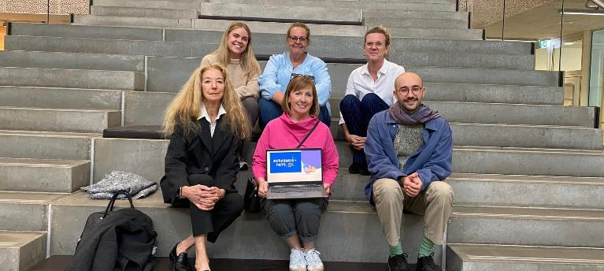


03 | MEET THE PARTNERS
01
Folkuniversitetet (Sweden)
Contribution:
Lead partner and overall coordinator of AI4S, responsible for co-designing the senior‑friendly AI learning modules, ensuring pedagogical quality, and guiding the project’s research‑to‑practice approach for adult educators.
FU also leads national dissemination across Sweden and supports educator training and senior engagement.
What expertise do they bring?
FU brings decades of experience in adult education, serving 140,000+ learners annually. Their long record in ICT‑enabled teaching and senior‑focused programmes ensures that AI4S resources are practical, accessible, and grounded in real adult‑learning needs.
Their leadership guarantees strong quality assurance and alignment with EU lifelong learning priorities
02
Momentum (Ireland)
Contribution:
Specialises in curriculum design & content creation for adults and further education in social inclusion & digital skills.
Translates research into clear, practical, ready‑to‑use resources for seniors, educators, and youth mentors.
Leads the W2W branding, communication, and dissemination strategies.
What expertise do they bring?
Momentum ensures that the OERs are pedagogically strong, visually compelling, accessible, and widely disseminated. Their expertise in adult education guarantees that resources are relevant and user-focused.
Their extensive experience in EU‑funded innovation projects ensures quality, scalability, and impact.

Slide 8



03 | MEET THE PARTNERS
03
SOSU Østjylland (Denmark)
Contribution:
Develops practice‑based AI learning activities grounded in real social‑ and health‑care contexts.
Provides insights into seniors’ daily support needs, ensuring materials reflect real‑life care environments.
Contributes to piloting, testing, and refining resources with diverse learner groups.
What expertise do they bring?
25+ years of experience in training social‑ and health‑care professionals, including those working directly with seniors.
Deep understanding of accessibility, safety, and digital‑skills needs among older adults in care settings.
Experience working with multicultural, multi‑age learners, ensuring inclusive and adaptable training approaches.
04
Fundación Cibervoluntarios (Spain)
Contribution:
Leader of intergenerational & community engagement, Cibervoluntarios Strengthens the intergenerational mentoring model through its extensive volunteer network.
Delivers accessible, volunteer‑supported AI workshops and awareness sessions
What expertise do they bring?
Extensive experience delivering digital‑skills training to vulnerable and low‑confidence users via a large volunteer network skilled in community‑based ICT support.
Proven methods for making technology accessible, safe, and confidence‑building for seniors.
Strong capacity for outreach and large‑scale grassroots engagement.
05
Gairmeach Training Ltd. (Ireland)
Contribution:
Acts as the technical partner for AI4S, developing senior‑friendly AI tools and digital learning applications.
Supports the integration of AI topics into adult and vocational education programmes.
What expertise do they bring?
A multidisciplinary team of instructional designers and developers in applying AI within adult and vocational education.
Strong capability in developing user‑friendly digital tools and e‑learning applications.
Experience in organisational change management to support smooth adoption of digital literacy programmes.

Slide 9
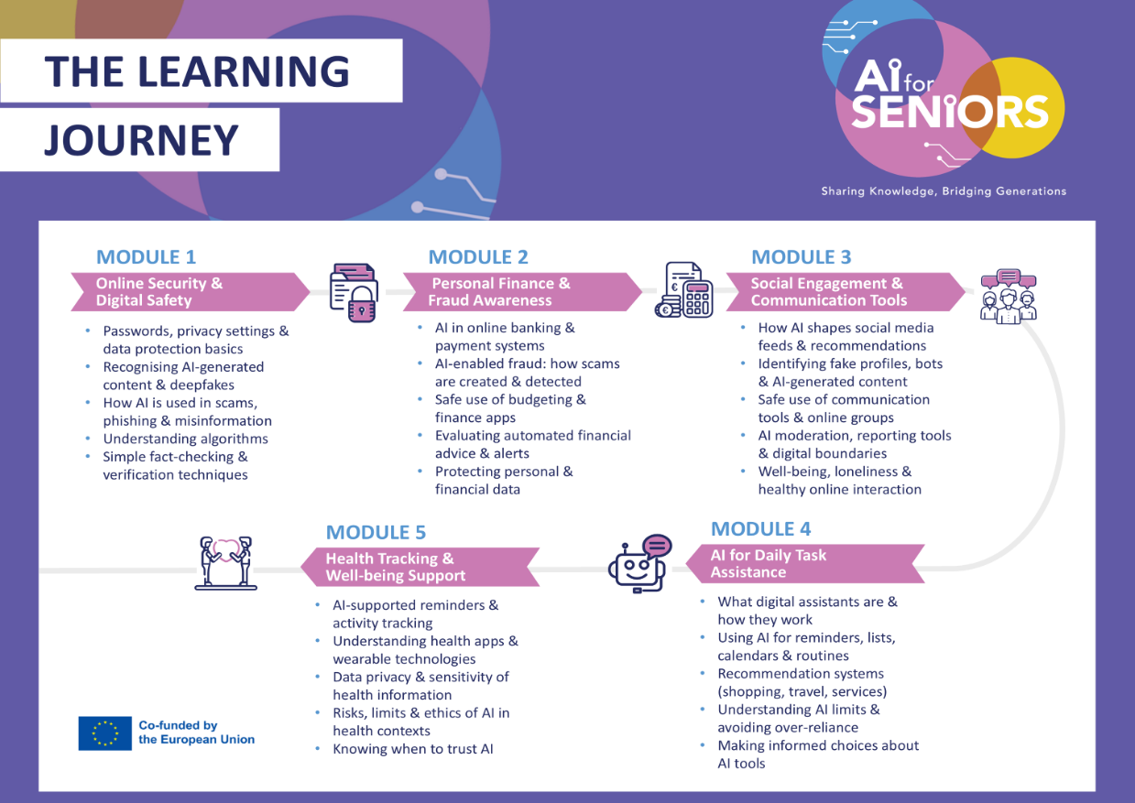
04 | THE AI FOR SENIORS COURSE
The AI for Seniors (AI4S) Course or Open Educational Resources (OERs) have been developed to empower you as a learner with the knowledge, tools, and confidence to navigate the world of Artificial Intelligence.
Our mission is to ensure that seniors are not just observers of the digital revolution, but active, informed participants.
The 5 free, flexible modules introduce essential practical AI skills tailored to everyday life and well-being. At the heart of these resources are three core goals:
Independence
Confidence
Inclusion
Whether you are an individual learner, an educator, or a community volunteer, these OERs are designed to demystify emerging technology, spark digital curiosity, and support social participation across generations.
This Digital Learner’s Toolkit complements the online modules by offering space to reflect, document your progress, and apply AI tools to your daily routine. It encourages you to explore possibilities at your own pace and take meaningful steps on your journey toward digital empowerment.

Slide 10

OERs
Open Educational Resources (OERs) are free learning materials that anyone can use, share, and adapt. They can include videos, worksheets, lesson plans, and interactive tools - all designed to support learning without cost or access restrictions. OERs help make education more open, flexible, and accessible for everyone.
KEY FEATURES OF THE OERs
Free & Open Access: Available to everyone — no cost, no login, no barriers.
Modular & Flexible: 5 standalone modules that can be followed in any order, at your own pace.
Real-World Focus: Based on real-life examples and tools, offering practical case studies and scenarios.
Interactive & Visual: Includes videos, graphics & engaging activities to support different learning styles.
Skill-Building: Covers key areas like digital safety, personal finance and fraud awareness, social connection and communication, and AI uses in health and well-being and daily tasks.
Locally Relevant: Inspired by regional challenges experienced by seniors across Europe, with tools and suggestions that can be adapted to your life or community setting.
Action-Oriented: Encourages learners to reflect, plan, and take steps toward digital acceptance and utilisation.
Suitable for All: Designed for seniors, educators, community groups, and anyone interested in AI for daily use and assistance.
TARGET GROUPS
The AI for Seniors (AI4S) course is designed with a multi-layered approach to ensure that learning is accessible, supported, and socially engaging.
Primary Target Group: Older Adults (Seniors)
The curriculum is built first and foremost for seniors who want to remain active and independent in an increasingly digital world. The modules are designed to meet you where you are, transforming AI from a complex technical concept into a practical everyday tool. Whether you are looking to secure your digital finances, monitor your health, or simply stay connected socially, these resources empower you to take control of your digital life.
Secondary Target Group: The Support Network (Trainers & Mentors)
Because we believe learning is more effective when shared, the AI4S modules also serve as a comprehensive training kit for those who support older adults:
Adult Educators & Community Leaders: Trainers at libraries, community centres, and NGOs can use the OERs as a structured curriculum to lead workshops and digital literacy classes.
Younger Adults (Family & Volunteers): The modules provide a roadmap for grandchildren, children, or younger volunteers to act as Digital Mentors. Instead of just fixing the computer for a senior relative, these resources give you the tools and pedagogical approach to teach them how to use AI confidently and safely.

Slide 11
Some General Instructions for the Course
Here are some instructions (which you can follow or not) to make your learning journey as easy as possible.
This course is scheduled to last an estimated 10-20 hours.
These hours can be distributed however you like and according to your schedule. Our advice is that you dedicate an hour a day from Monday to Friday, and rest on weekends.
Keep in mind that the entire course is 200+ slides. That means, if you spend an hour a day, you will have to review about 10 – 15 slides. This course was designed for flexible learning, and if you only have a spare 15 minutes, access the slides on your phone or tablet…it all counts.
You should also know that throughout the course you will find external documents and videos, which have a certain duration. In that case, do not hesitate to reduce the number of slides, and occupy exclusively the time that you have scheduled.
Finally…We all have days when we are more tired than others. So, if one day you don’t part-take in the course, that's fine. You deserve to rest. You will catch up but please don’t give up!
Study suggestions that will take your learning to another level
Create your own Mind Map. A mind map summarises and organises ideas. If you do it well, it can save you many hours of study time.
Buy a notebook just for the course. Write down everything you think is interesting. Then you be able to come back to it whenever you want.
The best way to learn is to be curiously active. Ask yourself questions about the subjects and do your best to answer them on your own. Click on the links for further reading and delve deeper. The finger icon indicates clickable links
Put what you have learned into practice. In the course, you will find a wide variety of easily applicable practices. Take advantage of them and test them out here in Section 5.
Especially, don't forget to enjoy yourself. Learning new things is a wonderful experience, whatever your age.

Slide 12

A LITTLE PROGRESS EACH DAY ADDS UP TO BIG RESULTS

Slide 13

05 |Overview of the 5 Modules & Activity Sheets
The following slides introduce every module in the course, along with straightforward exercises and real‑life examples. Each activity is designed to help you practice safely, build digital confidence, and apply your new skills immediately. Move through the modules in the order that suits you best.

Slide 14
Module 1: OVERVIEW & EXERCISES
MODULE 1 | Online Security & Digital Safety
Overview | This module helps you feel safer and more confident when using the internet, your phone, or any AI‑powered tools. It focuses on the everyday things that matter most: protecting your information, spotting scams, and knowing what to trust online. It’s designed to help you stay in control, avoid tricks or false information, and feel more confident online.
Learning Objectives | At the end of this module, you will be able to: Recognise common online risks, including scams, misinformation & unsafe AI-generated content Apply basic privacy, password & device security practices Assess the reliability of online information & recognise manipulative or misleading content
Topics Covered | Passwords, privacy settings & data protection basics Understanding how algorithms track behaviour & personalise content Understanding how algorithms track behaviour & personalise content Recognising AI-generated images, text & deepfakes Simple fact-checking & source verification techniques
Suggested Exercises | Slide 20 – A Safety check – Passwords, Updates & Privacy settings Slide 36 – Scenario based activity – recognising deepfakes Slide 43 – Spotting the difference (Real or AI)
Suggested Videos / Podcasts | WhatsApp Privacy Settings You Must Change For Safety and Protection How to Make Facebook Completely Private in 2026 Instagram Privacy Settings You MUST Change Today How to Clear Cache and Cookies in Google Chrome (2025 Update) How To Clear Cookies On Android How To Clear or Delete Cookies on iPhone (2025) How to Clear Cookies in Microsoft Edge [2026 Full Guide]
Further Reading | Snopes.com: The oldest and most famous site for debunking urban legends and internet rumours. FullFact.org: Great for checking political claims and "official" statistics. FactCheck.org: Excellent for health and science claims.

Slide 15
NOTES…SELF-REFLECTION…HOW TO THINK DIGITAL SAFETY:
_____________________________________________________________________________________________________________________________________________________________________________________________________________________________________________________________________________________________________________________________________________________________________________________________________________________________________________________________________________________________________________________________________________________________________________________________________________________________________________________________________________________________________________________________________________________________________________________________
______________________________________________________________________________________________________
______________________________________________________________________________________________________
______________________________________________________________________________________________________
______________________________________________________________________________________________________
______________________________________________________________________________________________________
______________________________________________________________________________________________________
______________________________________________________________________________________________________
______________________________________________________________________________________________________
______________________________________________________________________________________________________

Slide 16
Module 1 - EXERCISE 1
Your Digital Key: Secure Passphrases
1. The Passphrase Recipe
Forget random letters like Xy7!kP2. Instead, pick 3-4 random words that tell a story. This is easy for you to remember, but very difficult for a computer to guess.
TIP: Add a Twist: Add a Capital letter and a number to the end to make it extra strong.
2. Two Things to Avoid
The Grandkid Trap: Never use names or birthdays (e.g., Linda1955). Scammers can find this information on social media.
The Repeat Offender: Never use the same password for your Bank as you do for Facebook. If one lock is broken, the thief has the key to everything.
3. The Password Manager (Your Digital Vault)
You don't need to remember 50 different keys. A Password Manager (like Apple Passwords, Google Password Manager, or Bitwarden) acts as a digital address book. It stores all your keys behind one master passphrase. You only have to remember that one key!
4. Build Your Master Key
Use the spaces below to practice creating your new, strong master passphrase:
Write it here to test, then store it safely in your password manager
Password Checklist
Is it at least 12 characters long?
Is it unique (not used anywhere else)?
Is it memorable to you, but nonsense to a stranger?
Blue + Garden + Chair + 26

Slide 17

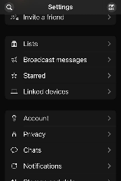
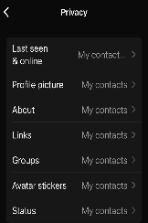

Module 1 - EXERCISE 2:
Adjusting your Privacy settings in WhatsApp
Follow this simple guide to adjust your privacy settings and ensure only the people you know can see your personal information.
How to Open Privacy Settings
Open the WhatsApp App on your phone.
Look at the bottom right-hand side of the screen.
Tap on Settings symbol ( a Cog)
Tap on Privacy.
Key Settings to Adjust
Need extra help?
If you prefer to watch, you can follow along with this video tutorial:
https://www.youtube.com/watch?v=4pvtGyWRaO8
Tip: WhatsApp will never ask for money or send you "verification codes" via text unless you requested one
Profile Photo & About Info: Tap these to change them to "My Contacts." This prevents strangers from seeing your photo or personal status.
Groups: Tap "Groups" and set it to "My Contacts." This ensures nobody can add you to a random group without your permission.
App Lock: (scroll down the page) Turn this on to require your fingerprint or face scan to open WhatsApp. This adds a great layer of physical security.

Slide 18


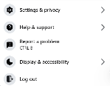

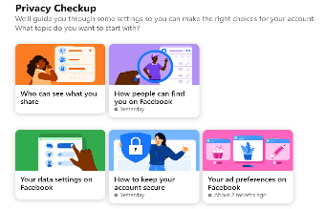
Module 1 - EXERCISE 3:
Adjusting your Privacy settings in Facebook
Facebook has a built-in tool called Privacy Checkup that walks you through everything. Follow these steps to make your account more secure.
How to Open Privacy Settings
Key Settings to Adjust
Need extra help?
If you want to watch the steps in action, check out this tutorial:
https://www.youtube.com/watch?v=4pvtGyWRaO8
Tip: Facebook updates its settings often. Using the Privacy Checkup tool is the best way to stay secure
Log in to Facebook on your computer.
Click on your profile picture in the top-right corner.
In the drop-down menu select 'Settings & privacy’ (cog icon).
Click on 'Privacy Checkup'.
Follow the prompts on the screen and choose these settings:
Who can see what you share: Set your Phone Number, Email, and Address to "Only Me" or "Friends." Set your Friends List to "Friends" only.
Posts & Stories: Set this to "Friends" so that only the people you know can see what you share.
Limit Past Posts: Click this option to automatically hide your old public posts from the general public.
How people can find you: Change "Who can send friend requests" to "Friends of Friends" if you want to be extra cautious. Turn off "Search Engine" access so people can't find your profile by Googling your name.

Slide 19

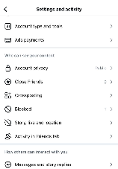
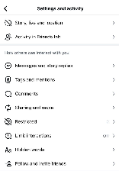
Module 1 - EXERCISE 4:
Adjusting your Privacy settings in Instagram
Instagram is great for photos, but it can share a lot of information if you aren't careful. Follow these steps to make your account more secure.
The Most Important Step: Private Account
These steps ensure that only people you approve can see your photos.
Other Key Settings to Adjust
Need extra help?
If you want to watch the steps in action, check out this tutorial:
https://www.youtube.com/watch?v=5DAbYSxQ3-E
Tip: Facebook updates its settings often. Using the Privacy Checkup tool is the best way to stay secure
Open the Instagram App and tap your profile picture in the bottom-right corner.
Tap the three horizontal lines (≡) in the top-right corner, to bring you to 'Settings and Activity’.
Tap 'Account Privacy’.
Turn on 'Private Account’.
Activity Status: In "Messages and story replies", turn off "Show Activity Status". This stops people from seeing when you are online.
Tags & Mentions: Go to "Tags and mentions" and choose "Manually approve tags". This stops strangers from tagging you in spammy photos.
Website Permissions: Review “App Website permissions" and disconnect any Apps you don't recognise.

Slide 20



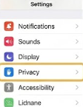


Module 1 - EXERCISE 5:
Stopping App Permissions: Avoiding Unnecessary ‘Listening’.
It can feel like your phone is listening, but often it’s just Apps accessing too many features, like your microphone or location. YOU have the power to stop them
Step 1: Open your SETTINGS App on your phone or tablet
Step 2: Find PRIVACY & SECURITY
In Privacy and Settings, you will find:
Location Services
Tracking
Microphone
Step 3: Check and Manage App Access
Within Location Services, Tracking and Microphone YOU can select which App requires access. Use the switches to urn off things an App doesn’t require for it to function.
Tip 1: A torch or a Calculator App does NOT need Location or Microphone. If they are asking, turn them OFF
Tip 2: Follow the Golden Rule, If an App doesn’t need access to location, microphone or tracking to perform its role – it shouldn’t have it.

Slide 21
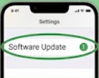

Module 1 - EXERCISE TEMPLATE 6:
Checking for Device Updates
Your phone or tablet needs regular check-ups called updates to stay fast and secure
Step 1: Open your SETTINGS App on your phone or tablet
Step 2: Find UPDATES or GENERAL
Either route will bring you to Software Updates
Step 3: Install Update and switch on Automatic Updates
Sometimes you will be required to plug your device into a power source and to be connected to WiFi for an update to install. Follow the instructions
Tip 1: If your device asks you to install an update, accept the update. Updates fix security holes that scammers try to use.

Slide 22
Module 2: OVERVIEW & EXERCISES
MODULE 2 | Personal Finance & Fraud Awareness
Overview | This module introduces learners to managing money safely in a digital world. It explains how online banking, payment systems, and financial apps work, while highlighting the growing risks of scams and fraud, including those enhanced by AI. The focus is on building confidence, awareness, and safe habits when handling personal finances online.
Learning Objectives | Use online banking and payment tools confidently Recognise scams, phishing, and AI-enabled fraud (e.g. voice cloning) Identify warning signs in messages, calls, and apps Protect personal and financial data Respond safely if targeted by fraud Verify financial information using trusted sources
Topics Covered | Introduction to digital finance and its risks and benefits How AI is used in banking and payment systems Safe use of banking and budgeting apps AI-enabled fraud and how scams are created Common financial scams and warning signs Evaluating alerts, advice, and financial information safely
Suggested Exercises | Multiple choice questions to test understanding of AI and banking alerts Scenario-based discussions (e.g. identifying suspicious messages or calls) “Helpful or Suspicious” activities comparing real vs fake communications Case scenarios (e.g. responding to urgent fraud alerts) to practise safe reactions
Suggested Videos / Podcasts | Introductory videos on safe digital banking practices A video explaining how scams are becoming more advanced using AI
Further Reading | Trusted banking guidance and official App resources Information on common scams and fraud prevention EU statistics and reports on digital finance and scam trends Practical guidance on staying safe online and verifying financial information

Slide 23
NOTES…SELF-REFLECTION…HOW TO KEEP YOUR FINANCES SECURE:
_____________________________________________________________________________________________________________________________________________________________________________________________________________________________________________________________________________________________________________________________________________________________________________________________________________________________________________________________________________________________________________________________________________________________________________________________________________________________________________________________________________________________________________________________________________________________________________________________
______________________________________________________________________________________________________
______________________________________________________________________________________________________
______________________________________________________________________________________________________
______________________________________________________________________________________________________
______________________________________________________________________________________________________
______________________________________________________________________________________________________
______________________________________________________________________________________________________
______________________________________________________________________________________________________
______________________________________________________________________________________________________
23

Slide 24




Module 2 - EXERCISE 1:
Safe Mobile Banking Habits
Step 1: Open Your Banking App
Open your official banking App on your phone or tablet.
Step 2: Check Your Account
Look at your account and review:
Your balance
Recent transactions
Any alerts or notifications
Make sure everything looks familiar and correct.
Step 3: Follow Safe Banking Habits
Do
Check your account regularly
Take your time when making payments
Double-check names, amounts, and details
Use official banking Apps or a trusted website
Avoid
Clicking unexpected links
Sharing your PIN, passwords, or security codes
Using public or unsecured WiFi for banking
Rushing decisions or payments
Tip
Use your official banking App to check alerts and activity.
Avoid acting on messages or links outside the App.

Slide 25


Module 2 - EXERCISE 2:
Spotting Suspicious Messages
Step 1: Look at the Examples
Warning Words to Watch For What the Message Asks You To Do
“Act now” Click a link
“Urgent” Share a security code
“Your account will be closed” Enter your password
“Immediate action required” Move money
“Suspicious activity detected” Reply with personal details
Step 2: Think About Your Experience
Have you ever seen messages like this before?
By text message
By email
By phone call
Stay Safe
If you see this type of message:
Do not click links
Do not share any details
Open your banking App yourself
Contact your bank using official details
Tip
Messages that create urgency are designed to make you act quickly.
Take your time and check through your official banking App.

Slide 26


Module 2 - EXERCISE 3:
If You Receive a Scam Phone Call
Step 1: Spot the Warning Signs
Be cautious if the caller:
Creates urgency
Claims there is a problem with your account
Asks for personal or banking details
Tells you to move money
Step 2: Pause
Take a moment. You do not need to respond immediately.
Step 3: End the Call
Say: “I will call back using the official number.”
Then hang up.
Step 4: Check Safely
Use your official banking App or contact your bank using trusted details.
Step 5: If You Have Already Acted
If you shared details or sent money:
Contact your bank immediately
Explain what happened
Follow their advice
Check your account for unusual activity
If something does not feel right, it is okay to pause. You are in control and can take time to check safely.
If this has happened to you, you are not alone. Support is available, and you can take steps to protect yourself.

Slide 27

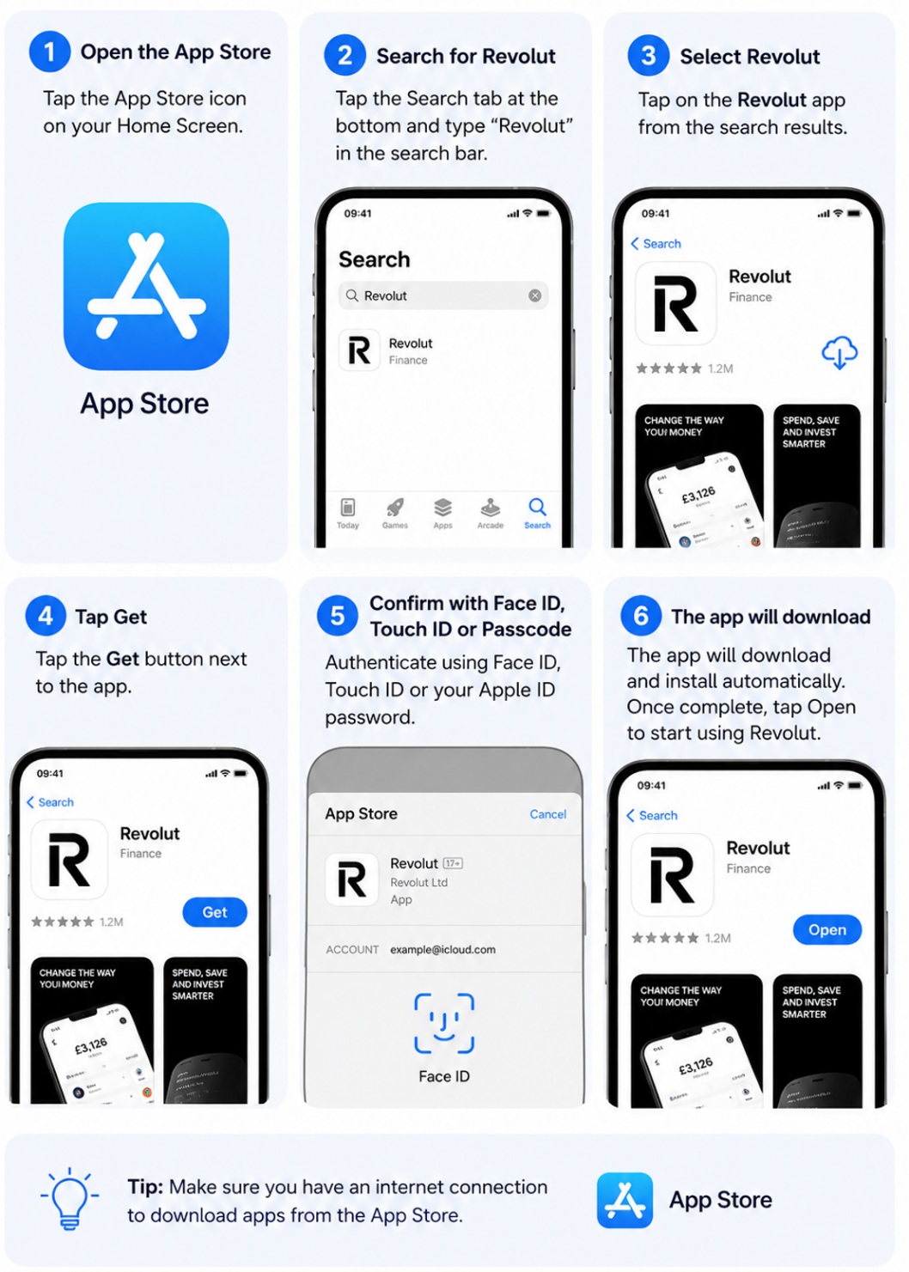
Step by Step: Download a Banking App Safely
This example uses an Apple iPhone and the Revolut app

Slide 28
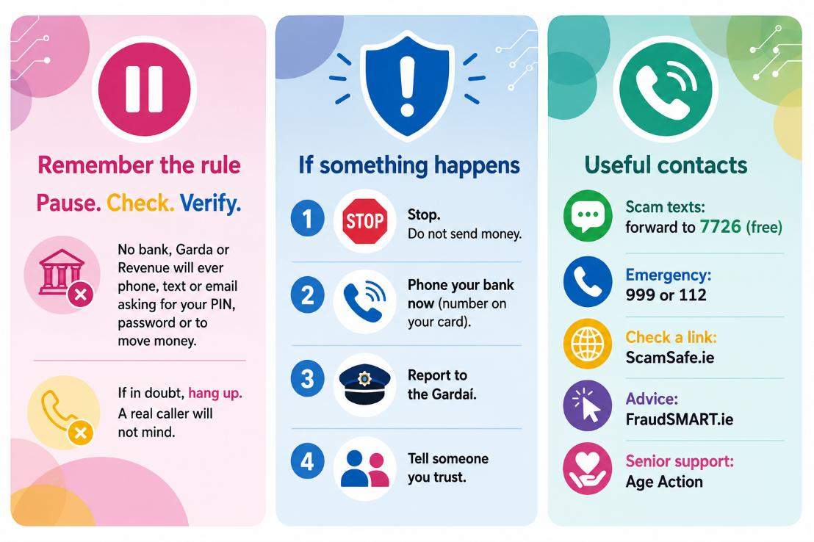
Module 2 - EXERCISE 4:
Quick Quiz Answer
Correct Answer :
B
Why?
AI can be useful, but learners should always verify important alerts using official sources.

Slide 29
Module 3: OVERVIEW & EXERCISES
MODULE 3 | Social Engagement & Communication Tools
Overview | This module helps you move from just using an App to owning your digital life. The idea is to transition from basic digital use to informed digital participation. It focuses on how AI shapes your social media feeds, gaining practical techniques to spot fake profiles, bots and AI generated contents It’s designed to help you understand how does it work, communicate with confidence and manage your digital space.
Learning Objectives | At the end of this module, you will be able to: Use digital communication tools to maintain social connections safely Identify inappropriate, misleading or AI-generated social content Apply ethical judgement & personal boundaries in online and AI-supported interactions
Topics Covered | How AI shapes social media feeds & recommendations Identifying fake profiles, bots & AI generated content Safe use of video calls, messaging & online groups AI moderation, reporting tools & digital boundaries Well-being, loneliness & healthy online interaction
Suggested Exercises | Slide 12 – Spotting the difference (Real or AI) Slide 33 - The digital traffic light Slide 34 - Reflection questions
Suggested Videos / Podcasts | UNESCO Ethics of AI: Challenges and Governance: https://www.youtube.com/watch?v=VqFqWIqOB1g IA Scams - Senior Planet AARP Foundation: https://www.youtube.com/watch?v=h1q8YwI51j0 AI: Five things you need to know | BBC Ideas: https://www.youtube.com/watch?v=CbyrgqR4Nko
Further Reading | What Is Artificial Intelligence (AI)? | IBM: Learn more about AI PhishSpot AI - Detect Fake Profiles & Protect Your Online Presence - learn more about how AI detects impersonators and fake engagement Don't be deceived: A practical guide to recognising AI on social media The Rise Of AI-Powered Content Moderation Tools | Blog | SIIT Reporting and blocking on social media: learn more about reporting and blocking on social media

Slide 30
NOTES…SELF-REFLECTION…HOW TO USE AI FOR SOCIAL CONNECTION:
_____________________________________________________________________________________________________________________________________________________________________________________________________________________________________________________________________________________________________________________________________________________________________________________________________________________________________________________________________________________________________________________________________________________________________________________________________________________________________________________________________________________________________________________________________________________________________________________________
______________________________________________________________________________________________________
______________________________________________________________________________________________________
______________________________________________________________________________________________________
______________________________________________________________________________________________________
______________________________________________________________________________________________________
______________________________________________________________________________________________________
______________________________________________________________________________________________________
______________________________________________________________________________________________________
______________________________________________________________________________________________________
30

Slide 31


Module 3 - EXERCISE 1:
How to spot fake profiles
If you have any doubts about the authenticity of a profile, it is important to check certain factors:
No real photos or photos that looks too perfect:
Identifying fake profiles on dating Apps and social media involves looking for photos that are either non-existent, stock-like, or too perfect (e.g., AI-generated or stolen modelling photos)
Strange username (numbers or symbols):
Strange, nonsensical usernames—particularly those combining random letters, excessive numbers, or symbols—are primary indicators of fake profiles, bots, or scam accounts on social media and dating Apps

Slide 32
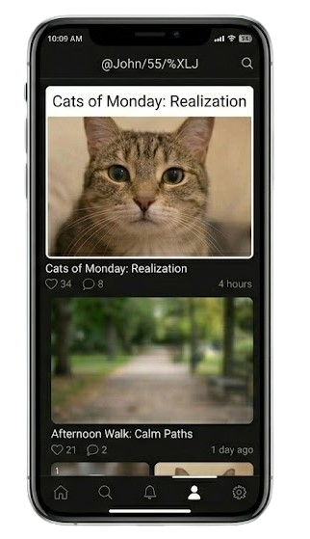
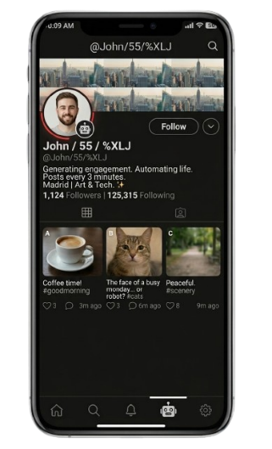
Module 3 - EXERCISE 1 Continued:
How to spot fake profiles
If you have any doubts about the authenticity of a profile, it is important to check certain factors:
Few posts / short comments:
Low Activity: Very few original posts, limited photos, or an empty timeline.
Newer Accounts: Often created within the last few months to a year.
Generic Comments: Short, scripted comments that often do not relate to the post (e.g., "Great post," "Nice photo," or random emojis).
Missing Information: Lack of personal details, friends, or followers.
"Locked" Profiles: Frequently, these accounts lock their profiles to prevent detailed inspection.
Very active all day, every day, at any time:
Posts every 3 minutes like clockwork
Comments, Nice post on 50 profiles in one minute
Follows thousands of accounts with zero engagement

Slide 33


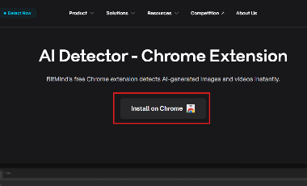
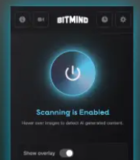

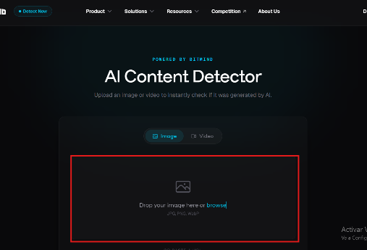
Module 3 - EXERCISE 2:
How to use Bitmind
Chrome Extension: Install the BitMind extension to detect AI content while browsing. Once installed, hover over any image to get an instant analysis:
Enter the Bitmind website and click on “Install on Chrome”
You'll see a new icon at the top of your browser. Click it to open. Sign in with your BitMind Platform account or continue anonymously.
Web Platform
Visit bitmind.ai to upload images or videos for verification.
Upload an image or video to instantly check if it was generated by AI.

Slide 34
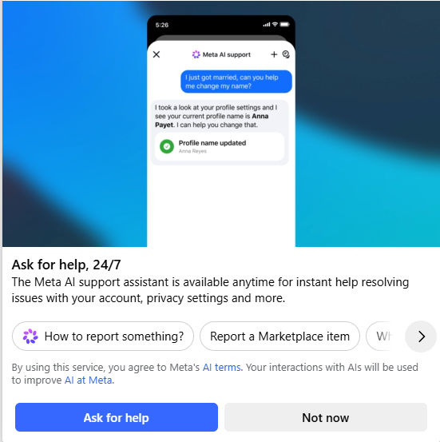
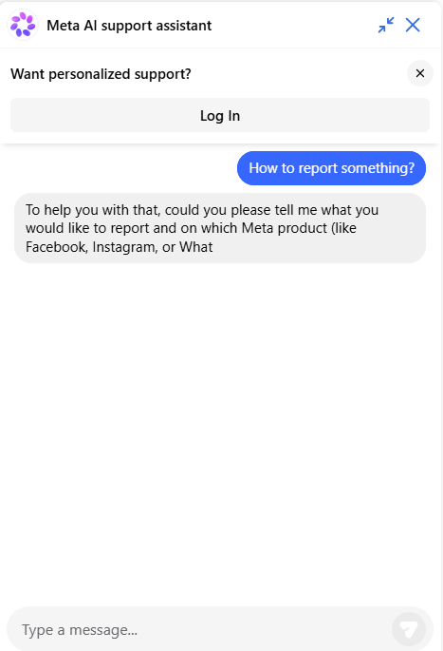
Module 3 - EXERCISE 3:
Reporting inappropriate content on Facebook
Help center: If you wish to report content that breaches Community Guidelines (e.g. nudity, behaviour that incites hatred or violence):
1
2
If you click on ‘How to report something?’, a chat window will open where you can find out how to report inappropriate content.
Tip: Provide the assistant with as many specific details as possible to ensure the most accurate categorisation. This helps both Meta AI and human reviewers to correctly prioritise and address the violation.

Slide 35




Module 3 - EXERCISE 4:
Generating AI messages
Choose: Open your favourite AI tool.
Choose between the different AI tools available (ChatGPT, Gemini, Copilot or any other!)
Context: Enter who it’s for and what it’s about.
Enter details like the recipient, purpose, and any specific information you want to include.
The more context you provide, the better the result!
Tone: Specify whether it’s formal or informal.
Decide on the tone. Most generators allow you to tweak this for optimal results.
Polish: Review and tweak the final text.
AI-generated messages are great starting points, but it’s important to review them to ensure they align with your voice and the situation.
Send: Copy, paste, and you’re done!

Slide 36
Module 4: OVERVIEW & EXERCISES
MODULE 4 | AI for Daily Task Assistance
Overview | This module introduces learners to how Artificial Intelligence (AI) can support everyday organisation, planning, and routines. It focuses on practical, real-life applications such as reminders, calendars, shopping lists, and recommendations. Learners explore how digital assistants (e.g. Siri, Google Assistant, Alexa, ChatGPT) can reduce cognitive load by helping with memory, task management, and daily planning. The module also highlights the importance of understanding AI limitations, avoiding over-reliance, and making informed decisions when using AI tools.
Learning Objectives | Use AI-supported tools for reminders, planning, and everyday organisation Understand how digital assistants support daily routines Recognise how recommendation systems work in everyday life Identify the limitations of AI and situations where caution is needed Make informed and safe choices when using AI tools
Topics Covered | What digital assistants are and how they work Using AI for reminders, lists, calendars and routines Recommendation systems (shopping, travel, services) Understanding AI limits and avoiding over-reliance Making informed choices about AI tools
Suggested Exercises | • Setting reminders and creating lists using AI assistants • Identifying personal daily tasks where AI could help • Experiences with AI recommendations • When to double-check AI information • Choosing safe and appropriate AI tools
Suggested Videos / Podcasts | Short demo: How to set reminders using Siri / Google Assistant Video: How voice assistants support daily routines Video: Understanding AI limitations and why verification is important Video: Tips for using AI safely in everyday life
Further Reading | • TILDA research highlights importance of digital inclusion for quality of life in older age - The Irish Longitudinal Study on Ageing (TILDA) - Trinity College Dublin Meet Siri, Alexa, and Google: A Beginner’s Guide to Voice Assistants | Sixty and Me • How Artificial Intelligence Is Transforming Everyday Life •Buying digital content and services

Slide 37
NOTES…SELF-REFLECTION…HOW TO USE AI TOOLS TO SUPPORT DAILY TASKS:
_____________________________________________________________________________________________________________________________________________________________________________________________________________________________________________________________________________________________________________________________________________________________________________________________________________________________________________________________________________________________________________________________________________________________________________________________________________________________________________________________________________________________________________________________________________________________________________________________
______________________________________________________________________________________________________
______________________________________________________________________________________________________
______________________________________________________________________________________________________
______________________________________________________________________________________________________
______________________________________________________________________________________________________
______________________________________________________________________________________________________
______________________________________________________________________________________________________
______________________________________________________________________________________________________
______________________________________________________________________________________________________

Slide 38

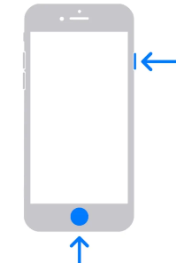

Module 4 - EXERCISE 1:
Using AI for Reminders & Daily Tasks
Step 1: Think About Your Daily Life
Write down 3 things you often forget:
• __________________
• __________________
• __________________
Step 2: Try Using AI
Option A: Voice (easiest)
Activate your assistant:
• Say “Hey Siri”, “Hey Google”, or “Alexa”
• Or press and hold the Home button
Follow the step-by-step instructions on the next pages
Option B: Text (if you prefer typing)
Open an AI App (for example: Google Assistant or ChatGPT)
Type your request, such as:
• “Create a reminder for tomorrow at 10 am”
Step 3: Reflect
• Was it easy to use?
• Would this help you in daily life?
Tip: AI reminders can help you stay organised and reduce stress.
The home button is usually one of these, depending on the phone you have

Slide 39


Module 4 - EXERCISE 1 Continued:
How to use AI for Reminders & Daily Tasks - Siri
Siri (Apple iPhone or iPad)
What you need
An Apple iPhone or iPad
Siri is already built into your device (no download needed).
Make sure Siri is turned on in Settings > Siri.
Step 1: Activate Siri
Say "Hey Siri", or
Press and hold the side button.
Step 2: Say your reminder
Examples:
"Remind me to take my medicine at 8 p.m."
"Remind me to call my daughter tomorrow."
Step 3: Siri confirms your reminder
Siri will repeat the reminder and ask for confirmation if needed.
You can also ask:
"What are my reminders today?"
"Show my reminders."
Before You Start
If this is your first time using a voice assistant:
Connect your device to the internet (Wi-Fi or mobile data).
Make sure the voice assistant is turned on.
Sign in with your Apple account if prompted.
Try saying "Hello" or "What can you do?" to test that it is working.

Slide 40

Module 4 - EXERCISE 1 - Continued:
How to use AI for Reminders & Daily Tasks - Alexa
Alexa (Amazon Echo devices)
What you need
An Amazon Echo smart speaker (or another Alexa-enabled device).
Download the Amazon Alexa app from the Apple App Store or Google Play Store to set up your device.
Sign in with your Amazon account.
Step 1: Activate Alexa - Simply say: "Alexa..."
Step 2: Say your reminder
Examples:
"Remind me to take my medicine every evening at 8 p.m."
"Remind me to call my doctor tomorrow."
Step 3: Alexa confirms the reminder
Alexa will repeat the reminder and notify you at the correct time.
You can also ask:
"Alexa, what are my reminders today?"
"Alexa, what's on my calendar?"
Before You Start
If this is your first time using a voice assistant:
Connect your device to the internet (Wi-Fi or mobile data).
Make sure the voice assistant is turned on.
Sign in with your Amazon account if prompted.
Try saying "Hello" or "What can you do?" to test that it is working.

Slide 41
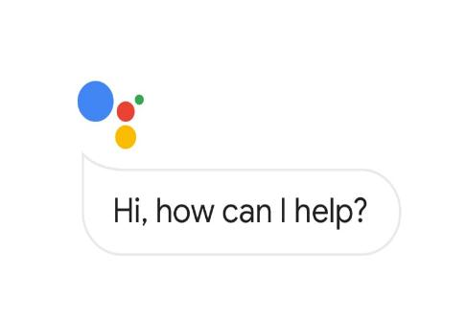
Module 4 - EXERCISE 1 Continued:
How to use AI for Reminders & Daily Tasks - Google
Google Assistant (Android Phones)
What you need
An Android smartphone.
Google Assistant is already installed on most Android devices.
If it is missing, download the Google app from the Google Play Store and sign in with your Google account.
Step 1: Activate Google Assistant
Say:
"Hey Google" or "OK Google", or
Open the Google app and tap the microphone.
Step 2: Say your reminder
Examples:
"Remind me to take my medicine at 8 p.m."
"Remind me to buy milk."
Step 3: Google Assistant confirms your reminder
The reminder will be saved and you will receive a notification at the chosen time.
You can also ask:
"What are my reminders?"
"What's on my calendar today?"
Before You Start
If this is your first time using a voice assistant:
Connect your device to the internet (Wi-Fi or mobile data).
Make sure the voice assistant is turned on.
Sign in with your Google account if prompted.
Try saying "Hello" or "What can you do?" to test that it is working.

Slide 42


Module 4 - EXERCISE 2:
AI Recommendations – Reflection Activity
Step 1: Think About Your Experience
Have you seen suggestions like this?
• Shopping online
• Movies or TV shows
• Travel routes
• Restaurants nearby
Step 2: Reflect
• Was the suggestion useful?
• Did it match your needs?
• Did you follow it or choose something else?
Step 3: Key Learning
AI suggestions can help, but they are not always correct.
Tip:
Always compare options and make your own decision.

Slide 43


Module 4 - EXERCISE 3:
When Should You Double-Check AI?
AI can make mistakes. It is important to know when to check information.
Step 1: Think About Risk Situations
Write down 2 situations where you should double-check AI:
• __________________________
• __________________________
Step 2: Discuss
Talk with a partner:
• Why is it important to double-check?
• Who can you ask instead?
Key Message:
AI is helpful, but it should not replace expert advice.

Slide 44
Module 5: OVERVIEW & EXERCISES
MODULE 5 | Health Tracking and Well-being Support
Overview | Using the digital tools you already have can be a great help in everyday life. A phone, tablet or smartwatch, can help with small everyday tasks. When you use the tools you already have, they can support you with small tasks, provide a quick overview, make it easier to keep track of habits, well-being, and thus create more peace of mind and clarity. Digital tools can be used without the need for advanced technical knowledge. Once you get to know the key features, you can decide what’s useful and what to turn off. It’s not about being tech-savvy – it’s about making everyday life a little easier.
Learning Objectives | Use digital tools for basic health organisation, reminders & activity Tracking Recognise the limitations and ethical considerations of AI in health contexts Critically assess health-related info & know when professional advice is required Integrated critical elements: Data sensitivity, ethics, and reliability of health information
Topics Covered | 1.AI-based reminders & Activity Tracking 2.Health apps & wearable technologies 3.Data privacy & sensitivity of health information 4.Risks, limits & ethics of AI in health contexts 5.Knowing when to trust AI & when to seek professional advice
Suggested Exercises You will find our suggested answers to the scenario exercises at the end of this digital toolkit | Exercises from the module: Slide 16: Scenario exercise 1 - ”Peter’s morning routine” Slide 24: Scenario exercise 2 – ” Ella and the step counter” Slide 32: Scenario exercise 3 - “John receives a pop-up” Slide 39: Scenario exercise 4 - “The watch says ‘Possible stress’” Slide 485 Scenario exercise 5 - “The sleep report that worries David”
Suggested Videos / Podcasts | How To Track Steps on iPhone Without Apple Watch How to Enable Step Counter on Any Samsung Phone (Samsung Health Setup)

Slide 45
NOTES…SELF-REFLECTION…HOW TO USE AI IN MY HEALTH MANAGEMENT
_____________________________________________________________________________________________________________________________________________________________________________________________________________________________________________________________________________________________________________________________________________________________________________________________________________________________________________________________________________________________________________________________________________________________________________________________________________________________________________________________________________________________________________________________________________________________________________________________
______________________________________________________________________________________________________
______________________________________________________________________________________________________
______________________________________________________________________________________________________
______________________________________________________________________________________________________
______________________________________________________________________________________________________
______________________________________________________________________________________________________
______________________________________________________________________________________________________
______________________________________________________________________________________________________
______________________________________________________________________________________________________
45

Slide 46
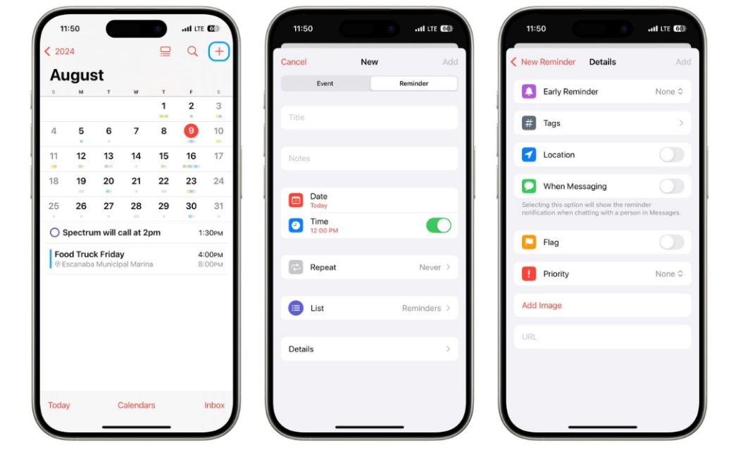
Module 5 - STEP BY STEP EXERCISE 1:
How to set a reminder on your phone
Cecilia Sten <cecilia.sten@folkuniversitetet.se>; Paula Whyte ( Momentum Consulting ) <paula@momentumconsulting.ie>; Anja Schneidermann <ans@sosuoj.dk>; Iben Roed Jensen <iro@sosuoj.dk>; César Isaac Veliz Paiz <cesar.veliz@cibervoluntarios.org>
1️⃣ Open the App
📱 Reminders or Calendar
2️⃣ Tap “+” or “New reminder”
3️⃣ Write your reminder
✏️ “Take blood pressure medication at 10:00”
4️⃣ Choose a time
⏰ Pick a time that fits your daily routine
5️⃣ Press “Save”✅
6️⃣ Check your reminder
📋 Can you see it in your list?

Slide 47
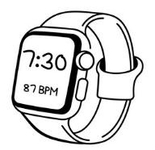


Module 5 - SCENARIO 1:
The answers to ”Peter’s morning routine”
What does the AI do here, and what does it not do?
Peter’s smartwatch (AI) suggests a time, because it has detected a
pattern in his behaviour.
The AI remembers the reminder for him when the time comes.
The AI does not decide whether Peter should take the medicine.
The AI does not know why the time is suitable - it guesses based on habits.
How can Peter control his reminder himself?
He can choose to accept or reject the suggestion.
He can change the time.
He can turn the reminder off when it is not convenient.
He can delete it completely if he does not want to use the feature.

Slide 48
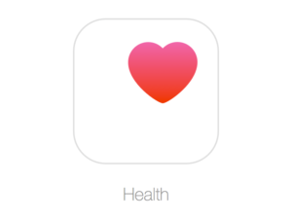

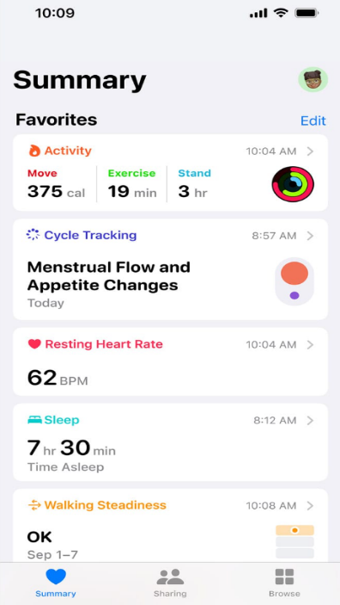
Module 5 - STEP BY STEP EXERCISE 2
Using the Health App on an iPhone
Learn how to use the Health app to view and track basic health and activity information.
Step 1: Open the Health App
Find the Health app on your iPhone.
Tap the app to open it.
Step 2: Check Your Steps
Tap the "Summary" tab.
Find "Steps."
Tap it to see how many steps you have taken today.
Step 3: View Your Activity Over Time
Look at the activity graph.
Switch between Day, Week, Month, or Year.
Notice any changes in your activity levels.
Step 4: Add Health Information
Tap your profile picture in the top right corner.
Select "Health Details."
Add or update information such as your height or weight (optional).
Step 5: Reflection
How many steps have you taken today?
Were you more or less active than you expected?
How could this app help you in your daily life?

Slide 49
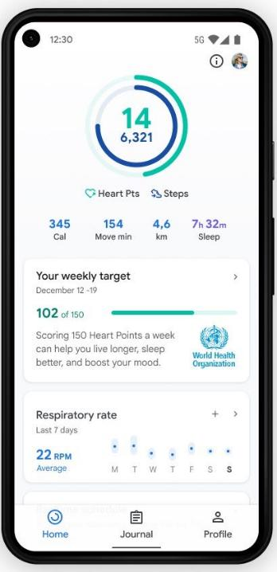
Module 5 - STEP BY STEP EXERCISE 2 - Continued
Using the Health App on Android
Learn how to use a health app, such as Google Fit, to view and track basic health and activity information.
Step 1: Open the Health App
Open the list of apps on your phone.
Find Google Fit or the health app installed on your device.
Tap the app to open it.
Step 2: Check Your Daily Activity
Look at the home screen.
Find your step count or daily activity summary.
Note how many steps you have taken today.
Step 3: View Previous Activity
Open the activity history or dashboard.
Look at your activity from previous days or weeks.
Compare different days.
Step 4: Add Health Information
Open the "Profile" or "Health Data" section.
Add information such as your height or weight (optional).
Step 5: Reflection
What did you learn about your activity level?
Was the information easy to find?
How could this app help you manage your health?

Slide 50


Module 5 - SCENARIO 2:
The answers to “Ella and the step counter”
What do the graphs tell Ella - and what don’t they tell her?
They show how much she has moved.
They show when her activity was at its peak.
They show the length of her sleep (if the measurement is accurate).
But they don’t tell us whether her activity or sleep is “good” or “bad”.
They don’t tell us how she’s feeling.
How can she use this as inspiration instead of judgement?
She can use the figures to spot trends - not as rules.
She can use them to fuel curiosity, not self-judgement.
She can correct small errors in the measurement
She can use them as motivation

Slide 51
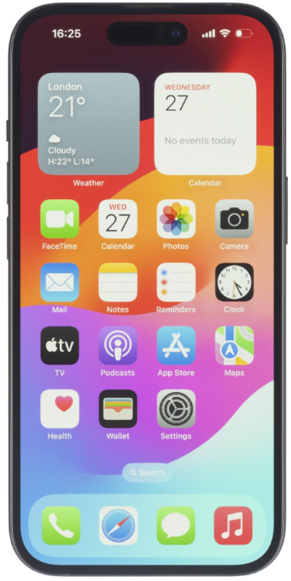
Module 5 - EXERCISE 3:
Protecting Your Privacy and Health Information
Learn how to protect your personal and health information when
using apps and AI tools.
Step 1: What Should Stay Private?
Full name
Home address
Heart condition
Daily step count
Discuss:
Which information would you share?
Which information should stay private?
Step 2: Check App Permissions
Open Settings on your phone.
Go to Privacy or Privacy & Security.
Select a health or fitness app.
Review what information the app can access.
Step 3: Safe AI Use
Compare these examples:
1: "I walked 5,000 steps today. How can I become more active?"
2: "My name is John Smith, I live at 25 Main Street, and I have diabetes."
Discuss:
Which example is safer?
Why should personal details be avoided?
Reflection
What is one thing you can do to better protect your privacy online?
Key Learning Point
Only share necessary information, and be careful with personal and health information when using apps and AI tools.

Slide 52





Module 5 - EXERCISE 3
The answer to Scenario Exercise 3
“John receives a pop-up”
Which data is “essential”, and which is just “nice to have”?
Essential data: data required for the feature to work (e.g. steps for a step counter).
Nice to have: everything else (e.g. location for an app that doesn’t use maps).
Apps often ask for more than they need.
How can John tell if sharing feels safe?
If he understands why the app is asking.
If the data seems relevant to the function.
If he can say no without the app stopping working.
If he feels that he is in control of the process.

Slide 53
Module 5 - STEP BY STEP EXERCISE 4:
Risks, Limits and Ethics of AI in Health
Understand what AI can and cannot do when it comes to health information.
Scenario
A person asks an AI tool:
"I have had chest pain for two days. What should I do?“
- The AI provides an answer.
Questions and Answers:
Should you rely only on the AI's answer?
No. AI can provide information, but it cannot diagnose medical conditions or replace a healthcare professional.
Can AI make mistakes?
Yes. AI may provide incorrect or incomplete information.
When should you contact a healthcare professional?
If you are concerned about your health or have serious symptoms, you should
seek professional medical advice.
Can AI be useful in healthcare?
Yes. AI can help explain information, answer general questions, and support healthy habits.
Key Learning Point
AI can be a useful source of information, but it should not replace a doctor or other healthcare professional when making health decisions.
💬
🏥

Slide 54


Module 5 - SCENARIO 4:
The answer to “The watch says ‘Possible stress’”
Why did the AI get this wrong?
Sensors react to movement, not just to health.
A brief change in heart rate isn’t necessarily a sign of stress.
AI doesn’t understand context — only numbers.
The watch might have been a bit loose or affected by movement.
What can Karin do to assess the message calmly?
Check her heart rate again after a few minutes.
Think about what she was just doing.
Check that the watch is fitted correctly.
Use the message as a hint — not a warning.

Slide 55
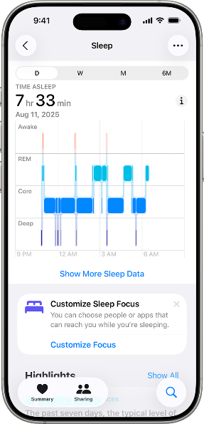
Module 5 - STEP BY STEP EXERCISE 5:
When to Trust AI and When to Seek
Professional Advice
Your app says:
“Your sleep was poor”
Ask yourself:
Is this general information or a medical warning?
Do I actually feel unwell or different today?
Is this something that worries me?
👉 If YES (I feel unwell or worried)
→ talk to a healthcare professional 👩‍⚕️🏥
👉 If NO (I feel fine)
→ it is general information
→ you can use it as a suggestion for healthy habits 💡
Key message
AI and health apps can inform you, but your own feelings and symptoms matter most.

Slide 56
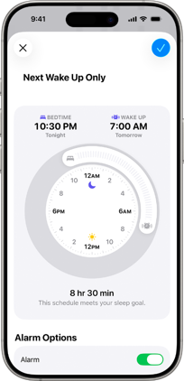

Module 5 - SCENARIO 5:
The answers to “The sleep report that worries David”
When does it make sense to act on AI advice?
When the advice is general and harmless (e.g. “get more exercise”).
When the advice is about well-being, not illness.
When the advice fits with how Jens himself experiences his day.
When is it best to consult a professional?
When there are symptoms.
When the AI advice seems worrying or alarming.
When the advice concerns health, diagnosis or risk.
When Jens is in doubt — doubt = consult a professional.

Slide 57
Sharing Knowledge,
Bridging Generations
06 | SUGGESTED TIME MANAGEMENT STRUCTURE
The AI for Seniors OERs have been created with an estimated duration of 10-20 hours
You are free to do it in your own way; and at your own pace however, we offer you a suggestion:
WEEK | TRAINING CONTENT | TIME ALLOCATION per Day
1 | Module 1 | Mon: 60mins, Wed: 60mins, Fri: Recap 60 mins
2 | Module 2 | Mon: 60mins, Wed: 60mins, Fri: Recap 60 mins
3 | Module 3 | Mon: 60mins, Wed: 60mins, Fri: Recap 60 mins
4 | Module 4 | Mon: 60mins, Wed: 60mins, Fri: Recap 60 mins
5 | Module 5 | Mon: 60mins, Wed: 60mins, Fri: Recap 60 mins

Slide 58

07 | USEFUL LINKS & RESOURCES
Project Website | https://ai4seniorsproject.eu/
Learning Resources | https://ai4seniorsproject.eu/resources/
Project Facebook Page | https://www.facebook.com/profile.php?id=61581906524284
Project Instagram account | https://www.instagram.com/ai_4_seniors/
Project LinkedIn Page | https://www.linkedin.com/company/ai-4-seniors/posts/?feedView=all

Slide 59
08 | GLOSSARY
On the following pages, you will find explanations of several of the different words you have come across in the modules. This Glossary is also available on the Project website. www.ai4seniorsproject.eu
All terms are listed in alphabetical order.
Term | Definition
AI Assistant | An AI Assistant (Artificial Intelligence Assistant) is an advanced computer programme that can understand complex questions, solve problems, and help with everyday tasks by reasoning and generating responses in a way that resembles human thinking.
AI-Enabled Fraud | AI-enabled fraud is when criminals use artificial intelligence to create highly realistic and personalised scams on a large scale. This makes scams harder to recognise because they often appear genuine and contain fewer obvious mistakes.
AI Moderation | The use of artificial intelligence to analyse, filter, and manage content published online by individuals or organisations.
AI Tools | Programmes that use artificial intelligence to help people complete tasks, create content, or understand information more easily.
Algorithm | A set of mathematical rules that enables a computer to recognise patterns, make decisions, and learn from data.
App (Application) | A programme on a smartphone, tablet, or computer that is designed to perform a specific task.
App Permissions | Settings that allow an app to access features or information on your device, such as your camera, location, microphone, or contacts.
App Updates | New versions of an app that provide security improvements, fix problems, or add new features.
Artificial Intelligence (AI) | The field of computer science that develops systems capable of learning, reasoning, problem-solving, and recognising patterns.
Cookie | A small text file stored on your device that helps a website remember your preferences, recognise your device, and provide personalised content or advertisements.
Data | A collection of facts, numbers, words, images, or other information.
Data Protection | Laws and security measures that help keep your personal information safe.

Slide 60
Term | Definition
Deepfake | A highly realistic fake video, image, or audio recording created using artificial intelligence.
Digital Assistant | A computer programme that responds to spoken or typed requests and helps with everyday tasks.
Digital Finance | The use of digital technology to manage money, make payments, and access financial services online.
Digital Payment Tools | Apps or online services that allow you to pay for goods and services or send money securely over the internet.
Digital Safety | The habits and behaviours that help protect you from harm while using the internet and digital technology.
End-to-End Encryption (E2EE) | A security method that ensures only the sender and intended recipient can read a message.
Fraud Prevention Notifications | Security messages warning you about possible fraud or unusual account activity.
Health Advice | Information or guidance about your health. Apps can provide general advice but cannot replace advice from a healthcare professional.
Healthcare Professional | A trained person, such as a doctor, nurse, physiotherapist, or pharmacist, who can assess your health and provide treatment or advice.
Heart Rate | The number of times your heart beats in one minute.
Investment Scam | A type of fraud in which criminals persuade people to invest money in fake or misleading opportunities.
Location Data | Information collected by your device that shows where you are.
Misinformation | False or inaccurate information that is shared without checking whether it is correct.
Online Security | The tools, settings, and technologies used to protect your devices, accounts, and personal information from unauthorised access, cyberattacks, and online threats.
Password | A secret combination of letters, numbers, and symbols that helps prove your identity when you sign in.
Pattern | Something that happens regularly or repeatedly.
Permissions | Settings that control what information or features an app can access.
Phishing | A type of scam in which criminals pretend to be a trusted person or organisation to trick you into sharing information or money.
Post | A piece of content shared online, such as text, a photo, a video, or a link.

Slide 61
Term | Definition
Privacy Settings | Settings that allow you to control who can see your information and how organisations use your personal data.
Prompt | The instruction, question, or text you give an AI tool.
Recommendation System | An AI tool that suggests products, films, music, or other content based on your interests.
Reminder | A digital note or alert that helps you remember to do something at the right time.
Scam | A dishonest attempt to trick you into giving away money, personal information, or something else of value.
Sensitive Data | Private information that must be protected, such as passwords, bank details, identification numbers, or medical records.
Sleep Tracking | A feature that measures how well and how long you sleep.
Smart Home | A home where internet-connected devices and appliances can be monitored or controlled remotely or automatically.
Social Bots | Automated computer programmes that imitate human behaviour on social media.
Social Media Feed | The personalised stream of posts, images, videos, advertisements, and other content shown on a social media platform.
Spending Summaries | Features in banking apps that show how you spend your money over time.
Steps | The number of steps you take during the day.
Suspicious Transaction Alert | A warning that a payment or transaction appears unusual and should be checked.
Transaction Verification | The process of checking that a payment or financial action is genuine and authorised before it is completed.
Two-Factor Authentication (2FA) | A security method that requires two forms of identity verification, such as a password and a code sent to your phone.
Unusual Activity Detection | The process of identifying account activity that does not match normal patterns and may indicate fraud.
Wearables | Electronic devices worn on the body, such as smartwatches or fitness trackers, that monitor health and activity.

Slide 62

www.ai4seniorsproject.eu
Follow our journey

