Slide 1

Online Security & Digital Safety
MODULE 1

Slide 2
Throughout this module and the AI for Seniors Course…If you come across any unfamiliar words or technical terms, you can find simple explanations in the AI for Seniors Glossary on our website at any time!
www.ai4seniorsproject.eu

Slide 3
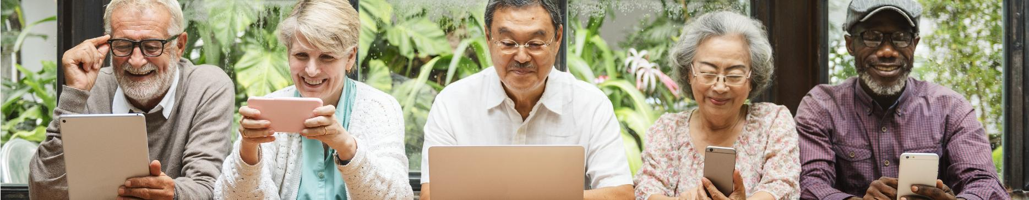

Contents
01
Passwords, privacy settings & data protection basics
02
Understanding how algorithms track behaviour & personalise content
03
Understanding how algorithms track behaviour & personalise content
04
Recognising AI-generated images, text & deepfakes
05
Simple fact-checking & source verification techniques

Slide 4

MODULE 1: LEARNING OUTCOMES
– At the end of this module,
Learners will be able to:
Recognise common online risks, including scams, misinformation & unsafe AI-generated content
Apply basic privacy, password & device security practices
Assess the reliability of online information & recognise manipulative or misleading content

Slide 5
Understanding both terms…
Think of it like a house:
Online Security is the high-tech alarm system and the deadbolt on the door.
Digital Safety is knowing not to invite a suspicious stranger inside or share your floor plan with the whole neighbourhood.
The internet is like a busy city. Most people are friendly, but we still lock our doors at night

Slide 6

Digital Safety (The Who & Why)
Safety is behavioural. It’s about human interaction and personal habits that keep you away from harm.
In this module, we focus on Personal well-being and social interaction.
Key Threats: Phishing, smishing, identity theft through social engineering, and online scams.
Common Practices:
Privacy Settings: Choosing who sees your photos.
Digital Footprint: Being mindful of what you post today that could haunt you in years to come.
Critical Thinking: Spotting a too good to be true scam or a fake news story.

Slide 7

01
PASSWORDS, PRIVACY SETTINGS & DATA SECURITY

Slide 8
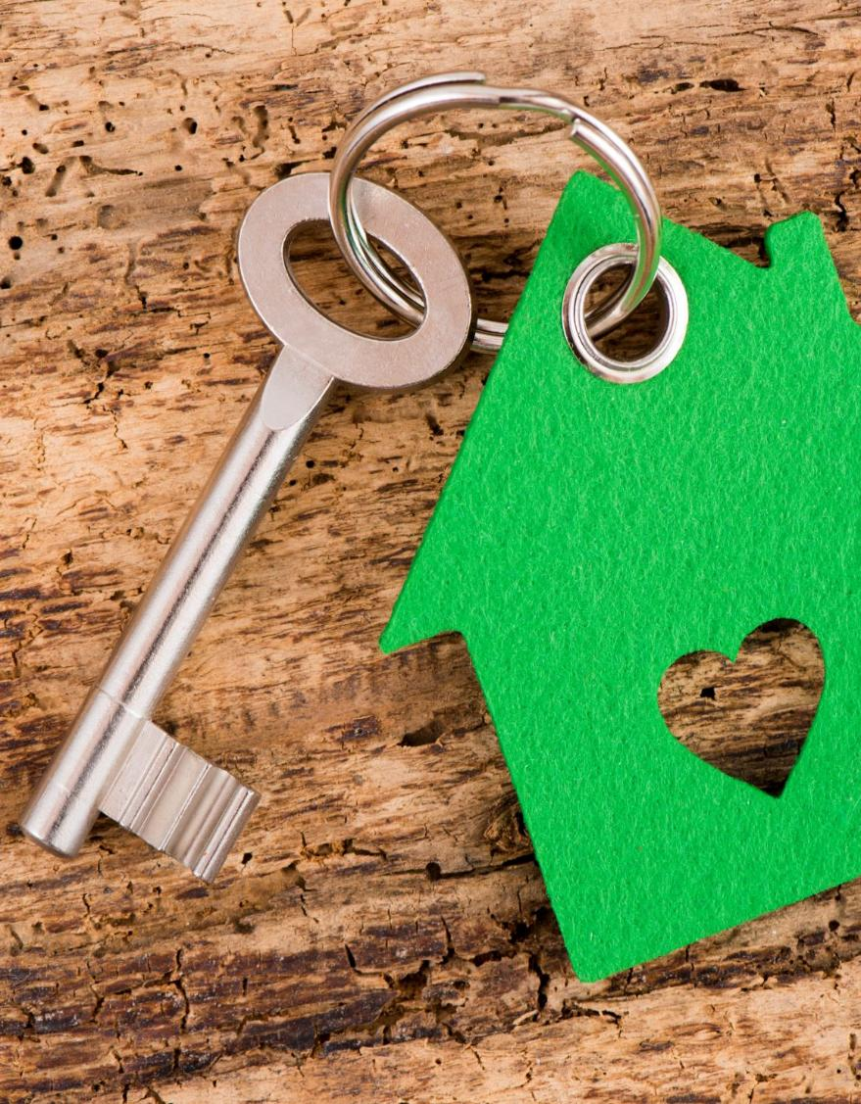
Why Do We Need Passwords & Settings?
Imagine walking into a bank or a doctor's office. You wouldn't want the person standing behind you to see your bank balance or your medical history. In the physical world, we have walls and private rooms.
Online, we have Passwords and Privacy Settings that protect our Data.

Slide 9
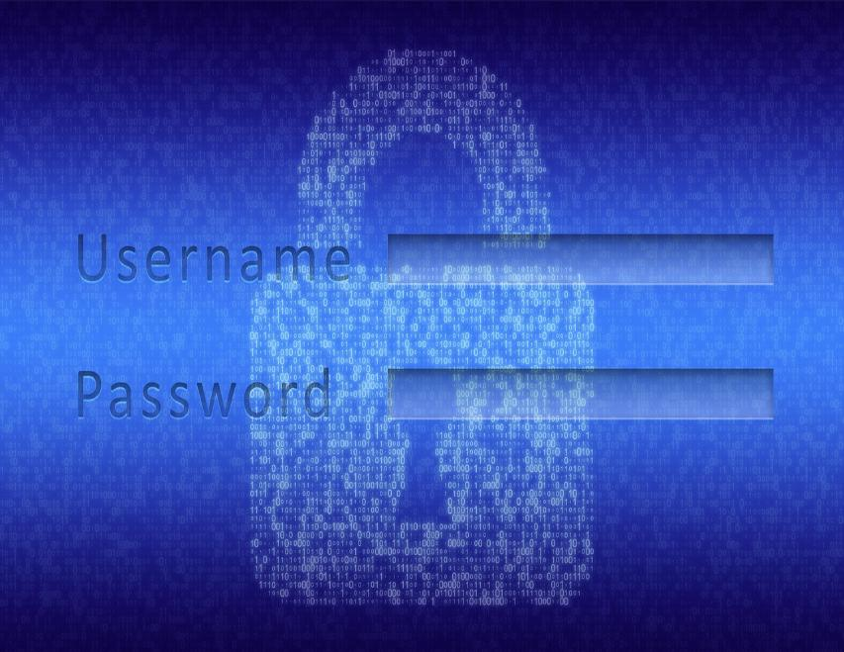
The Digital Key: Passwords
A password is a secret code that proves you are who you say you are.
The Job: It keeps your digital room (like your email or bank account) locked so only you can enter.
Why Websites Ask for Them: Websites store your personal information (address, credit card, family photos). They require a password to ensure they aren't giving your private info to a stranger.

Slide 10
Your Digital Key
⁰¹
⁰³
Move from Passwords to Passphrases.
Use 3-4 random words strung together…Example: blue-garden-chair.
Two Things to Avoid
The Grandkid Trap
The Repeat Offender
Add a Personal Twist
To make it even stronger, add a capital letter and a number. Example: Blue-Garden-Chair-26
Passphrases are much longer (which computers hate) but tell a story (which humans love).
⁰²

Slide 11

What to AVOID:
The Grandkid Trap: Avoid using just names and birthdays (e.g., Linda1955). Scammers can find this info easily on social media.
The Repeat Offender: Never use the same password for your Bank as you do for your Facebook. If one lock is broken, the thief has the key to everything.
Making your PASSPHASE Strong & Simple

Slide 12


TIP: Use a Password Manager
You don’t need to remember 50 passwords!
A Password Manager is like a digital address book that stores all your "keys" behind one Master Key. EG., Apple Passwords (iCloud Keychain) used on Apple devices or Google Password Manager used on Android phones or the Google Chrome Browser
You only have to remember one strong passphrase to unlock everything else.
Password Checklist :
Is it at least 12 characters long?
Is it unique (not used elsewhere)?
Is it memorable to you, but nonsense to a stranger?
See the exercise sheets in the Learner’s Digital Guide for steps on how to carry out these tasks

Slide 13
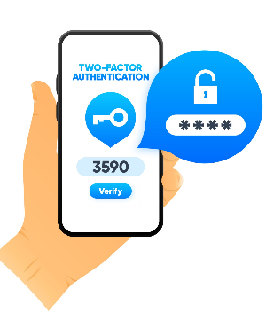
What is Two-Factor Authentication?
Think of it as a Double Lock for your most important digital doors (like your bank or email). Even if a thief manages to steal your password (the first key), they still can’t get in because they don't have the second key.
How It Works (The 3 Simple Steps)
Log In: You type in your username and password as usual.
The Check: The website says…Wait! I need to make sure it's really you. It sends a secret code to your physical phone (usually via a text message).
The Proof: You type that code into the website. Since only you have your phone in your hand, the website knows it’s safe to let you in.
TIP: If you ever receive a code on your phone when you aren't trying to log in, it’s a warning! It means someone else tried to use your password, but the double lock stopped them.
Other terms for this are: MFA (Multi-Factor Authentication) or 2-Step Verification

Slide 14


Privacy Settings: The Digital Curtains
If a password is the lock on your front door, privacy settings are the curtains on your windows.
Their Job: They allow you to choose who can see what you are doing.
Giving you a Choice: You might want your family to see your vacation photos, but you probably don't want a telemarketer or a stranger in another country to see them. Settings let you flip a switch from Public (everyone can see) to Private (only friends/family).

Slide 15
Privacy Settings: Who is looking in your window?
Most people don’t realise that social media DEFAULTS are usually set to public!!
Therefore, it is a good idea to follow these rules:
Check out the Videos on the next slide to adjust your PRIVACY SETTINGS
⁰¹
⁰³
App Permissions
A Social Media Audience Check
Learn how to change settings from Public to Friends Only.
Study your permissions, e.g., a flashlight app doesn't need access to your Contacts or Location…so don’t give it to them.
The Post-Test
Remember, if you wouldn't put this on a physical bulletin board at the local library, don't post it on Facebook.
⁰²

Slide 16
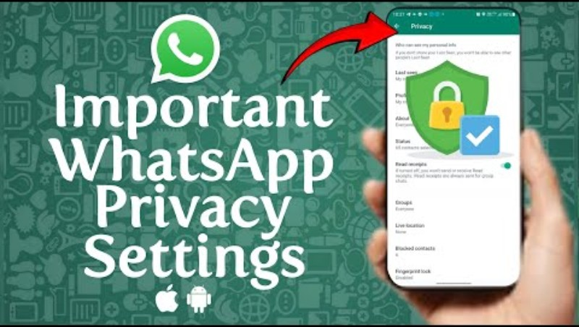

Privacy Settings
Below are a few video links to show you how to adjust your privacy settings on commonly used Apps. It is worth checking out your current settings
WhatsApp Privacy Settings You Must Change For Safety and Protection
How to Make Facebook Completely Private in 2026
Instagram Privacy Settings You MUST Change Today
More instructions available here

Slide 17

Smartphone Eavesdropping & App Permissions
We all often feel like our phones are listening to us. This is usually just an app having too much access.
How to avoid unnecessary listening…
Open "Settings" on your phone (the silver gear icon ).
Find "Privacy" or "Apps."
Check the Microphone & Location:
Look for a list of apps. If a Torch or Calculator app is asking for your Location or Microphone, turn it OFF.
Rule of Thumb: If the app doesn't need it to work, it shouldn't have it.
More instructions available here

Slide 18

The Vault: Data Protection
Data protection is the practice of keeping your digital paperwork safe from being stolen or lost.
What is Data? Whenever you use the internet, technology companies collect pieces of information about you. This is your ...Personal Data.
The Goal: To make sure that if a digital thief (hacker) tries to get into a website you use, your personal information is scrambled (encrypted) so they can't read it.
Personal Data
What they see:
Websites you visit
What you buy
Things you click on
What you share:
Your Name
Your email
Your Birthday

Slide 19

Data Protection: Guarding your Digital Paperwork
Some TIPS for better Data Protection:
Public Wi-Fi Danger: Using Free Airport/Cafe Wi-Fi for banking is like talking about your finances in a crowded elevator. Best practices is to wait until you are on a trusted home network.
The Update Myth: Many people click Remind me later on software updates because they fear it will change their layout. However, updates are actually Digital Band-Aids that fix holes hackers use to get in.
Device Locking: Ensure your tablet or phone requires a PIN, fingerprint, or face scan to open.

Slide 20
Take Control
Securing your digital life is just like locking your front door and pulling the curtains. By switching to Passphrases, you’ve made your digital locks much stronger. By adjusting your Privacy Settings, you’ve decided exactly who is allowed in your digital living room. These simple habits are the foundation of a safe (data-protected) online experience.
Physical World | Digital World | What it protects
Front Door Key | Password | Your "Entry" (Login)
Window Curtains | Privacy Settings | Your "Visibility" (Who sees your posts)
Fireproof Safe | Data Protection | Your "Valuables" (Credit cards, ID, Photos)

Slide 21
Learner Exercise
Passwords:
Consider changing your most used passwords – turn your favourite song lyric or a good memory into a 12+ character phrase (Include one special character & a number)
Updates:
Check your phone or other devices for software updates and click Install now
Privacy:
Check your Social media Apps – Privacy Shortcuts turn off all unnecessary settings
Sharing:
Never text or email passwords or PANs (Personal Access Numbers)
TIP:

Slide 22

02
UNDERSTANDING ALGORITHMS

Slide 23

Algorithms & Tracking
Think of an algorithm as a digital recipe. Just as a recipe follows steps to make a cake, an algorithm is a set of instructions a computer follows to solve a problem or decide what to show you next.
Algorithms are designed to be helpful, but their main goal is to keep you looking at the screen. They don't always care if the information is true or healthy; they only care if it's something you are likely to click on.

Slide 24

How They Track & Personalise
Algorithms watch your digital body language to learn what you like. Here is how they work:
The Trail: Every time you Like a photo, watch a video, or search a website, the algorithm takes a note.
The Profile: It uses these notes to build a profile of your interests (e.g., Loves gardening, is interested in history).
The Personalisation: The next time you log in, the algorithm serves you content it thinks you’ll stay to watch. This is why two people can look at the same App but see completely different news and ads
A cookie is a tiny file that a website places on your device. It isn’t a programme; it’s just a small note.
If a cookie (note) says what you did, the algorithm is the brain that decides what to do with that information.

Slide 25

Watch the relevant VIDEO for you…
How to Clear Cookies
How To Clear Cookies On Android
How To Clear or Delete Cookies on iPhone (2025)
How to Clear Cookies in Microsoft Edge [2026 Full Guide]
Note: by clearing cookies, you are essentially telling websites, Forget what you know about me. You will be automatically signed out of your active websites and treated like a new visitor.
How to Clear Cache and Cookies in Google Chrome (2025 Update)

Slide 26

03
HOW AI IS USED IN SCAMS, PHISHING & MISINFORMATION

Slide 27
Explaining The Terms…
Scam (the Theft)
Misinformation
Phishing (The Hook)
A Scam is a dishonest scheme designed to trick you out of something valuable—usually your money or your identity.
Phishing is the method used to carry out a scam. It is an email, text (Smishing), or phone call that pretends to be from a trusted source to hook you
Misinformation is false or inaccurate information that is spread online, usually to change your opinion of something

Slide 28
How to Spot a SCAM
How they do it:
The Message: You get a text or email that looks official (from the Tax Office, the Post Office, or your Bank).
The Problem: It says there is a "suspicious transaction" or you have an "unpaid fine" that will result in a penalty if not paid today.
The Link: They provide a link to a website that looks identical to your bank's real login page.
The Theft: When you type your username and password into that fake site, the scammer captures them in real-time and logs into your real bank account to steal funds.
Regardless of the story, almost every scam follows the Three P’s:
Pretend
¹
They pretend to be someone you trust (Family, Bank, Government).
Problem
²
They create a crisis or an emergency.
Pressure
³
They demand you act immediately (transfer money, or click a link) before you can think clearly.

Slide 29
Scammers have upgraded their old tricks using Artificial Intelligence (AI).
AI makes scams look and sound more REAL than ever before.

Slide 30
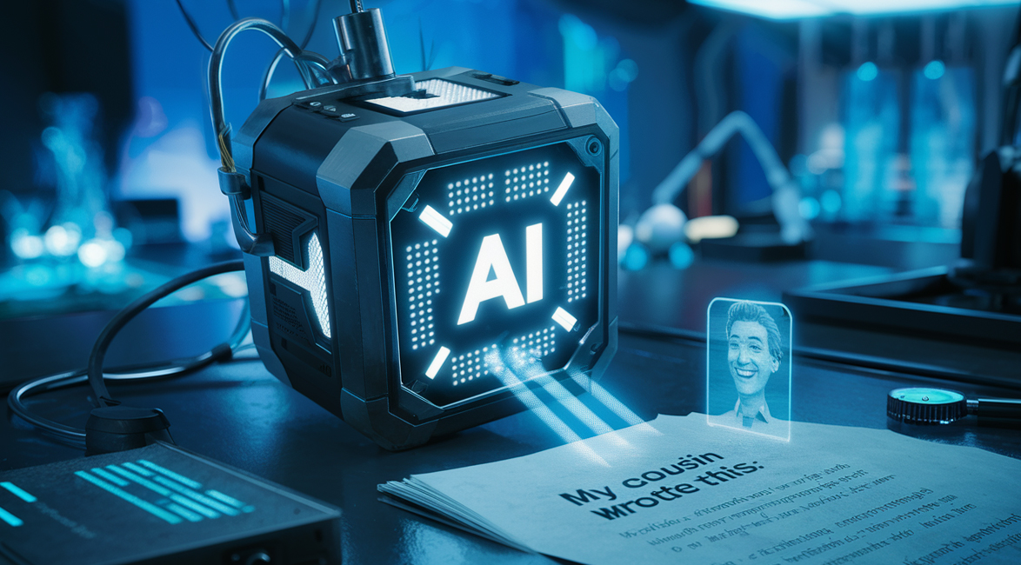
AI being used unethically…
In the past, scammers had to pretend to be someone else. Now, they use AI to mimic the voices/image or videos of people you love or trust.
Emails & messages often had spelling mistakes, or poor translations, but now ChatGPT or similar are used to write professional-sounding emails
The Golden Rule: If an email, text, or phone call makes you feel panicked, excited, or rushed—STOP. Take a breath, put the phone down/don’t respond, and talk to a friend or family member about it first.

Slide 31
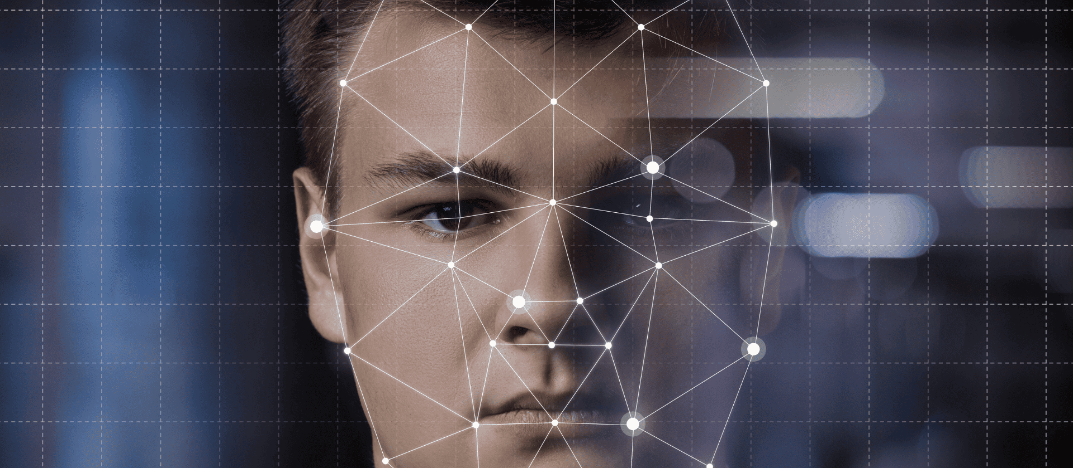
04
RECOGNISING AI-GENERATED IMAGES, TEXT & DEEPFAKES

Slide 32
AI Images & Text…
In the past, making a fake photo required professional editing skills. Now, anyone can do it by simply typing a description.
How AI creates images: It works like a digital artist. You give it a prompt (e.g., "An astronaut riding a horse in the style of Van Gogh"), and the AI builds that image from scratch using what it knows about colours, shapes, and art styles.
How AI creates text: Think of AI as a machine with limitless learning capability. AI tools have read millions of books & websites, so it can write letters, stories, or emails that sound exactly like a real person.

Slide 33
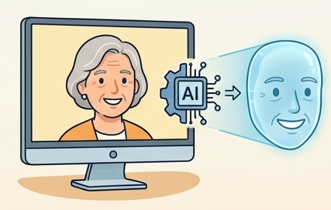
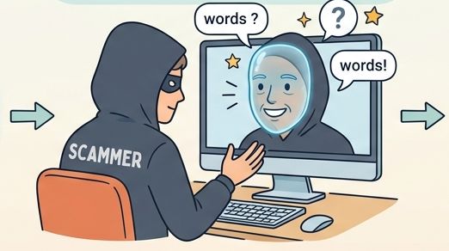
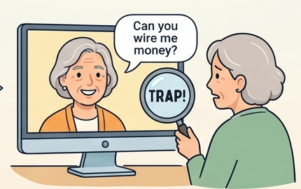
What is a Deepfake?
Answer: AI making fake videos look real!
voice
Can you send me money
words
AI creates a perfect replica of a face
The scammer WEARS this digital mask in a video
It looks and sounds convincing, but it is FAKE
VOICE CLONING – AI can also clone a voice from even a small sample to create fake calls/videos

Slide 34

Deepfake Video
Here is an example of a very realistic AI-generated video using a celebrity voice. This is deepfake tech at work!
AI can create realistic videos of people saying things they never actually said! This can be fun for entertainment, but also dangerous if misused (which is why digital literacy is important!).
Video link

Slide 35

How to Spot the Fakes
As AI gets better, the signs get subtler. In 2026, we look for physical glitches that the computer hasn't mastered yet.- It is not always possible to detect the real from the fake.
Checking Images:
The Hand Test: AI often struggles with fingers. Look for people with six fingers, hands that look melted, or fingers that are unnaturally long.
The Background Blur: Look past the main person. Are the buildings behind them warped? Is the text on signs unreadable gibberish?
Unnatural Smoothness: Does the skin look too perfect? Real faces have pores, wrinkles, and slight imperfections. AI faces often look like waxy dolls.

Slide 36
How to Spot the Deepfakes
AI has become incredibly good at mimicking reality. However, because AI doesn't understand the physical world the same way we do, it still leaves behind subtle clues.
Checking Videos:
The Blink Test: Humans blink naturally every few seconds. In some deepfakes, the person may not blink at all, or they might blink in a strange, robotic rhythm.
The Shadow check: Look at the lighting. Is the light hitting the person’s face from the left, but their shadow is falling to the left too?
The Mouth Match: Watch closely to see if the words match the lip movements. It might look like an old dubbed movie where the sound is a split-second off.

Slide 37
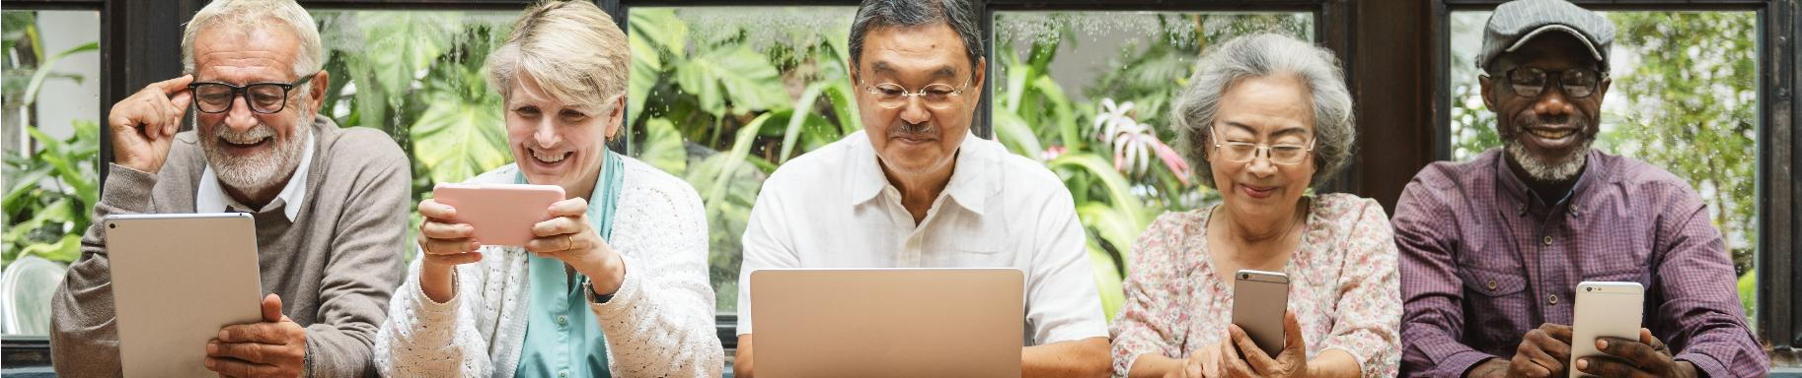
Learner Exercise:
Select which scenario is likely a Deepfake:
Scenario A: You see a video of a famous news anchor reporting on a local event. The audio is clear, but when they turn their head, their ear briefly becomes a blurry smudge before sharpening again.
Scenario B: You see a video of the same anchor, and though the lighting is a bit dim, their facial features stay sharp as they move.

Slide 38
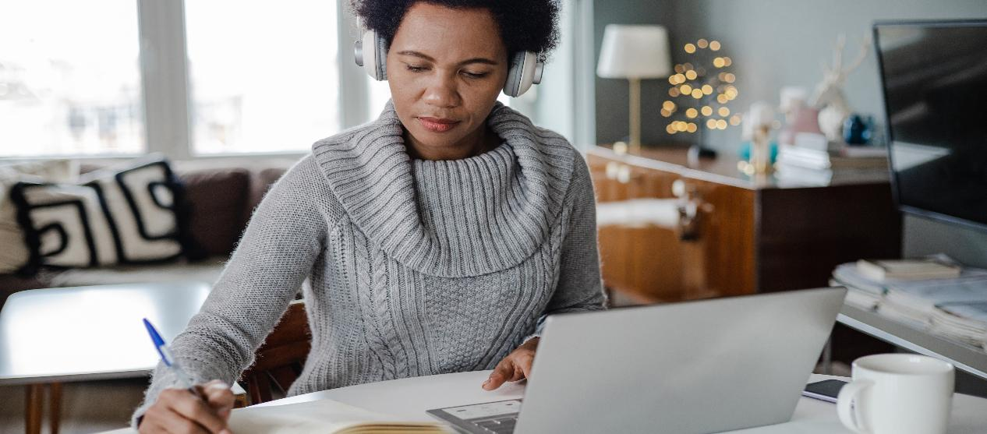
05
SIMPLE FACT-CHECKING & SOURCE VERIFICATION TECHNIQUES

Slide 39
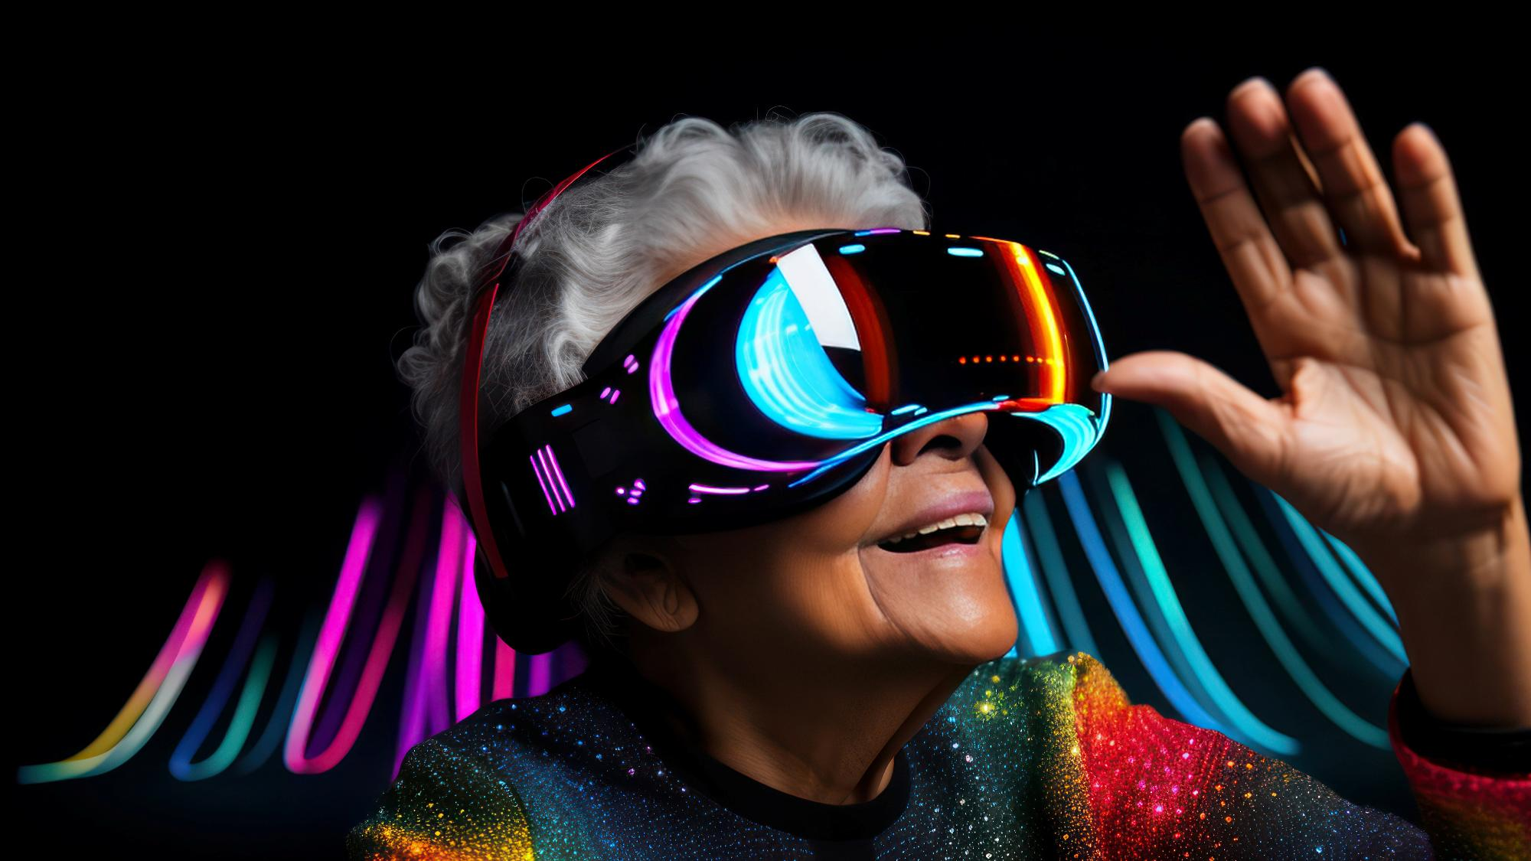
Becoming a Digital Detective
When you see a shocking headline or a strange photo, don't just wonder if it’s true—check it. Here are three simple techniques that professional fact-checkers use every day.

Slide 40
1. The SIFT Method
This is a simple checklist to use the moment you see something suspicious:
S
I
F
T
Stop:
If a post makes you feel very angry, worried or excited, stop. Don't share it yet
Investigate:
Who wrote this? Click on their name. Are they a real news organisation or just a random person?
Find – Better Coverage:
Do a Google search – are trusted sites reporting it too?
Trace – back to the original:
If a post says "A new study shows...", try to find the actual study.

Slide 41
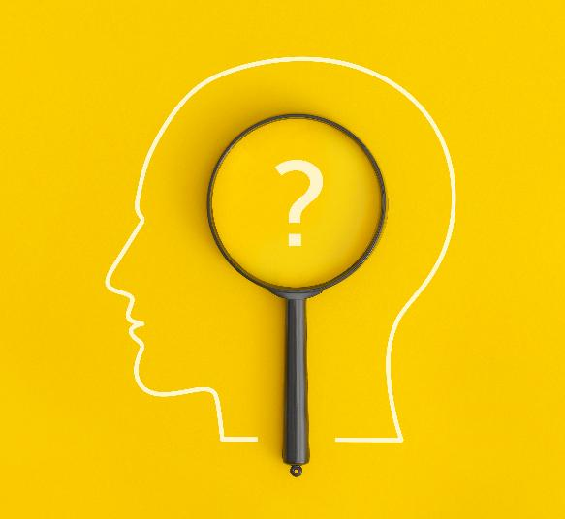
2. Lateral Reading
Most people check if a website is real by looking at the About Us page. Scammers write those pages themselves!
Instead of staying on the website, open a new tab in your browser.
Search for the name of the website or the author + the word reliability or complaints.
See what other people say about the site, rather than what the site says about itself.

Slide 42
3. Reverse Image Search
If you see a photo that looks too good (or too bad) to be true, you can ask the internet where it came from.
How to do it:
Right-click any image on your computer (or press and hold on a tablet).
Select Search Google for Image or Search with Google Lens.
What it tells you: It will show you every other place that the photo appears. You might find that a recent photo of a storm was actually taken 10 years ago in a different country!

Slide 43

Create a List of trusted Sites
When in doubt, visit these non-partisan websites that do the hard work for you:
Snopes.com: The oldest and most famous site for debunking urban legends and internet rumours.
FullFact.org: Great for checking political claims and "official" statistics.
FactCheck.org: Excellent for health and science claims.

Slide 44

Learner Exercise
Watch this video to practice spotting the differences between real and AI generated Videos –
Practice makes perfect
Can You Spot The Difference in Real Vs AI Videos in 2025? (Guessing Challenge)

Slide 45

Nothing EVER goes away once it is posted online.

Slide 46

Congratulations you have just completed Module 1, keep going on your learning journey…Module 2 discusses AI in Personal Finance and Fraud Prevention.
Follow our journey
www.ai4seniorsproject.eu

