Slide 1
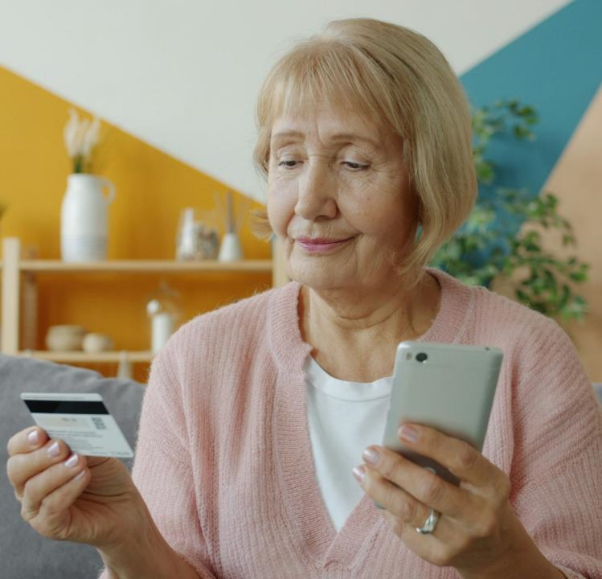
Personal Finance & Fraud Prevention
MODULE 2

Slide 2
Throughout this module and the AI for Seniors Course…If you come across any unfamiliar words or technical terms, you can find simple explanations in the AI for Seniors Glossary on our website at any time!
www.ai4seniorsproject.eu

Slide 3


Contents
01
Getting Started with Digital Money
02
How Your Bank Uses AI to Protect You
03
Choosing and Using Apps Safely
04
How Scams Work and How AI Powers Them
05
Spotting Scams and Warning Signs
06
Staying in Control and Getting Help

Slide 4
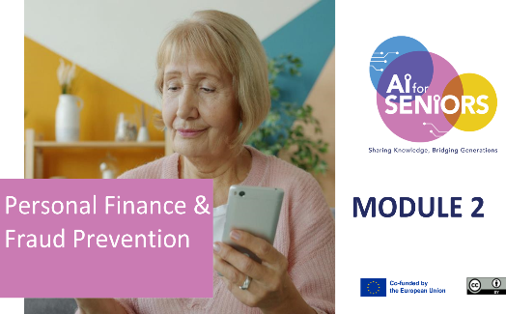
MODULE 2: LEARNING OUTCOMES
– At the end of this module,
Learners will be able to:
Use online banking and banking apps with more confidence, and recognise the official apps used in Ireland.
Spot financial scams, phishing and AI-powered fraud, including fake texts, deepfake voices and bogus investment adverts.
Recognise the three warning signs of a scam, and check whether a message, call or alert really comes from a trusted source.

Slide 5
MODULE 2: LEARNING OUTCOMES
– At the end of this module,
Learners will be able to:
Keep personal and financial details safe with simple habits across your phone, apps and accounts.
Create and store strong passwords safely, using a password manager or a secure written note.
Stay calm during a suspicious call or message, end it safely, and check independently before acting.
Know what to do if you are targeted by fraud, including who to contact in Ireland and how to report it.

Slide 6

01
GETTING STARTED WITH DIGITAL MONEY

Slide 7

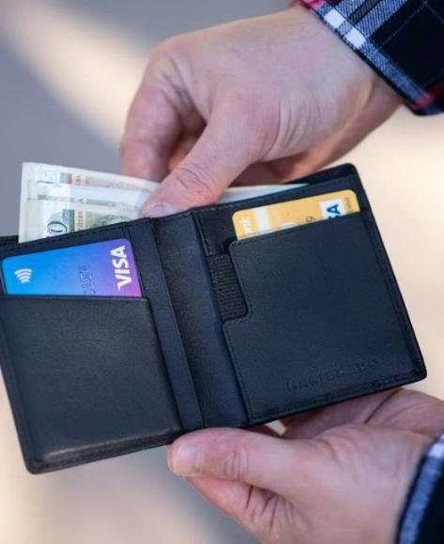
Managing money has changed
Many everyday financial tasks now happen through:
phones
tablets
websites
banking apps
These tools can make managing your money easier from home, but it is important to understand how to use them safely.
Notes:
UNSPLAH PHOTO CREDIT - Photo by Emil Kalibradov on Unsplash

Slide 8

Why this matters now
Digital finance is now part of daily life for many people.
People regularly use digital tools to:
check bank accounts
pay bills
transfer money
receive alerts
track spending
shop online
This can make managing money easier, quicker and more convenient.
Around 95% of people in Ireland now use online banking (Eurostat, 2025).
Notes:
****LOCAL EXAMPLE****
STATISTIC FROM - https://ec.europa.eu/eurostat/statistics-explained/index.php?title=Digital_society_statistics_at_regional_level&utm

Slide 9
Why this matters now
As digital finance has grown, scams have also become more common and
more convincing.
Scams affect millions of seniors:
78% of Irish adults are targeted by a scam text, email or call at least once a month
€160 million was lost to payment fraud in Ireland in 2024, up almost 25% in a year
Over €20 million was lost to investment scams in 2025, with people in their 50s most often targeted
Scams do not only cause financial harm. They can also reduce:
Confidence
Independence
Digital Participation
Notes:
****LOCAL EXAMPLES*****

Slide 10
Digital finance brings both benefits and risks
Risks
fake messages
copied apps or websites
pressure to act quickly
impersonation scams
requests for money or information
Benefits
saves time
makes payments easier
helps track spending
supports independence
allows access from home

Slide 11

Why Seniors Are Often Targeted
Scammers may target people who:
trust familiar organisations
are less familiar with digital systems
want to act quickly to fix a problem
Important reminder
Being targeted is not a sign of weakness
Scammers are trained to create:
urgency
fear
confusion
emotional pressure
These are normal human reactions
Notes:
UNSPLASH PHOTO CREDITS - https://unsplash.com/photos/a-woman-holding-her-head-in-her-hands-XWGUsWWopJc

Slide 12


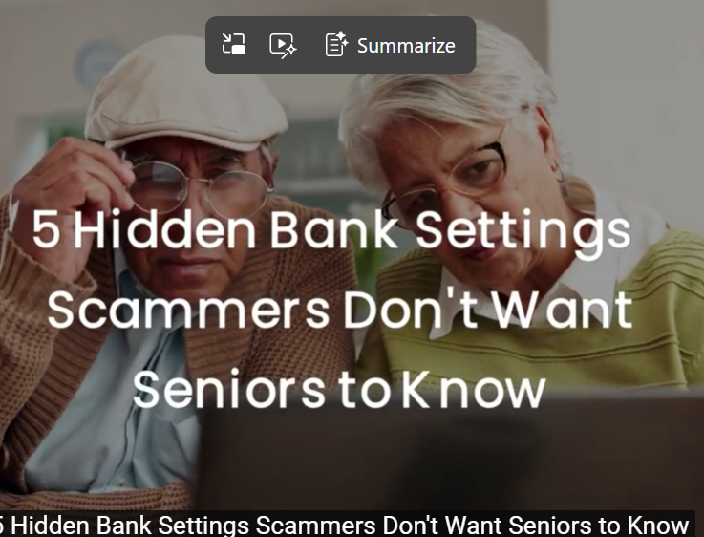
Watch and Reflect
Digital banking can be convenient, but it is
important to use the safety features available
through your bank and device.
As you watch, think about
Which protections seem most useful?
Which settings do you already use?
What could you check later on your own account?
5 Bank Settings That Stop Financial Fraud for Seniors
https://www.youtube.com/watch?v=2RH1s7jYygQ
Notes:
****LOCAL EXAMPLE****

Slide 13

02
HOW YOUR BANK USES AI TO PROTECT YOU

Slide 14

How AI works in your banking
Many banking systems use AI to operate in the background.
It helps to:
manage large numbers of transactions
recognise patterns in your account activity
understand what is normal for you
respond quickly when something changes
You may notice this when:
your bank asks you to confirm a payment
a transaction is paused or delayed
you receive alerts or reminders
AI helps your bank respond quickly and keep your account safe.
Notes:
UNSPLASH PHOTO CREDIT - https://unsplash.com/photos/the-bank-of-ornate-classical-columns-and-facade-714uXLBwczM

Slide 15

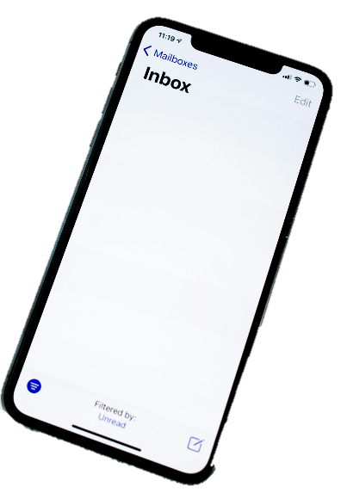
How banks respond to unusual activity
If something does not match your usual activity,
your bank may:
send you an alert
pause a payment
ask you to confirm your identity
This gives you time to:
review what is happening
decide what to do next
These checks are there to protect your money.

Slide 16

AI supports you, but you stay in control
AI can:
improve security
highlight important activity
make banking quicker and easier
But it cannot:
make decisions for you
understand your full situation
guarantee that all messages are genuine
So always:
pause before acting
check information carefully
use trusted sources

Slide 17
The golden rule: pause and check
No real bank, An Garda Siochana or Revenue will ever phone, text or email you and ask for your PIN, password, card details or to move money.
Check it
yourself
Phone your bank on the number on the back of your card, not one they give you.
Never feel
rushed
Scammers create panic. Take your time. It is always fine to say no.
Hang up
If a call feels wrong, just hang up. A genuine caller will not mind.
Q: What if the message is in the same thread as my real bank texts? A: It can still be fake. Scammers can copy a sender name. Always check independently.
Notes:
****LOCAL EXAMPLE****

Slide 18
Quick Quiz
Which statement is correct?
If a message mentions fraud, it must be genuine
AI can help banks spot unusual activity, but people still need to verify alerts
AI means you no longer need to check transactions
A banking chatbot can replace a human adviser in every situation
Notes:
LINK

Slide 19

03
CHOOSING AND USING APPS SAFELY

Slide 20

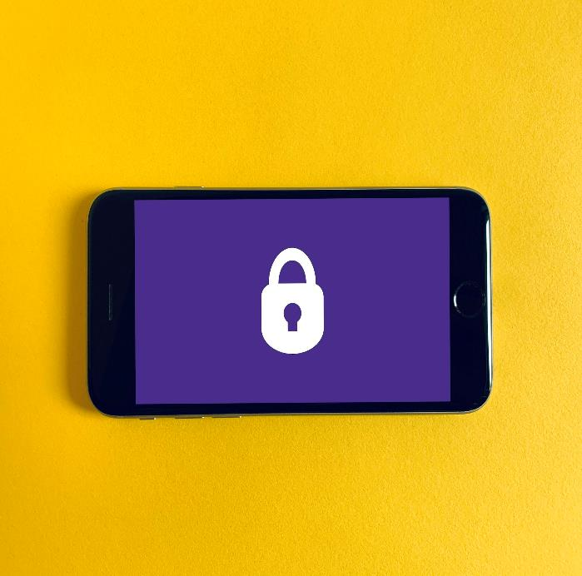
Choose apps you can trust
Before using an app, make sure it is reliable.
Look for:
a well-known bank or provider
clear branding and correct spelling
strong ratings and consistent reviews
regular updates
Be cautious if:
the app looks unfamiliar or poorly designed
the name is slightly different from
a known brand
Notes:
UNSPLASH PHOTO CREDIT -https://unsplash.com/photos/black-iphone-5-on-yellow-textile-DoWZMPZ-M9s

Slide 21
Trusted apps used in Ireland
These are well-known, regulated providers. Always download the official app from the app store, and remember: none of them will ever ask for your PIN or password by call or text.
Banks and An Post
Digital money apps
Revolut — Spending, transfers and currency
AIB - Allied Irish Banks app and online banking
Your credit union - Many now offer apps and online access
Bank of Ireland - Mobile banking and Banking 365
PTSB - Permanent TSB mobile app
N26 — Simple online-only current account
An Post Money - Current account with savings Jars
Zippay — New in-app way to send money between AIB, Bank of Ireland and PTSB
Not sure if an app is genuine? Check it on www.ScamSafe.ie
or download only from your bank’s official website. If in doubt, ask in your local branch.
Notes:
****LOCAL EXAMPLE****

Slide 22
Step by Step: Download a Banking App Safely
1
2
3
4
5
Check before you install
Look for the official bank as the maker, lots of reviews, and a recent update date.
Install, then open it yourself
Tap install. When ready, open the app from your own screen, not from any message.
Set up safely
Use a strong passcode or fingerprint. Turn on alerts so your bank can warn you of unusual activity.
Start in the right place
Open your phone’s official app store (App Store on iPhone, Play Store on Android). Do not use a link from a text or email.
Search the bank’s exact name
Type your bank’s name yourself. Check the spelling carefully, scammers copy real names with small changes.

Slide 23

Where to keep your passwords safely
A password manager / phone keychain
Written down at home, offline
Good points
Remembers strong, different passwords for you
Built into most phones already (free)
Fills them in so you never type them
Watch out for
You must remember one strong main password
Takes a little setup the first time
Good points
Simple, nothing to learn
Cannot be hacked from the internet
Easy to keep in a safe place
Watch out for
Keep it hidden, not by the computer
No use if lost; tell one trusted person where it is
Q: What makes a strong password? A: Three random words joined together, like BlueKettleRiver. Long is stronger than complicated. Avoid something predictable like a birthday or a pet's name. (see Module 1)

Slide 24

Understanding access and control
Know what you are agreeing to
When installing an app, you may be asked to allow access.
Take a moment to check:
what information it wants
why it might need it
whether it feels reasonable
Be cautious if:
the request seems unrelated
too much access is required
You can say no to permissions you are unsure about.

Slide 25

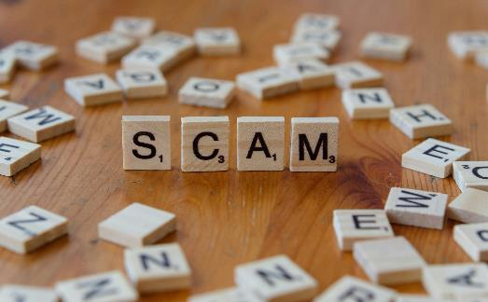
Everyday safe behaviour
Simple actions can help protect you:
check your account regularly
review transactions you do not recognise
avoid rushing when making payments
double-check names, amounts, and details
take your time before confirming anything
Slowing down helps you spot mistakes or
risks.
Notes:
UNSPLASH PHOTO CREDT –https://unsplash.com/photos/scam-spelled-with-scrabbles-on-a-wooden-table-FjyseC7iV3k

Slide 26

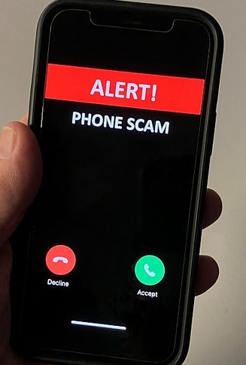
Keeping your device secure
Your phone or tablet is part of your
security.
Make sure you:
use a lock screen PIN or password
keep your device updated
avoid sharing your device or passwords with others
install updates when prompted
Notes:
PHOTO CREDITS - https://x.com/MenloParkPD/status/1846960843411611887/photo/1

Slide 27
Helpful or Suspicious?
Read each example and decide:
Does this seem helpful, suspicious, or do you need more information?
Example 1
Your banking app shows:
“Unusual payment detected. Please confirm if this was you.”
Example 2
You receive a text saying:
“Urgent fraud alert. Click here now or your account will be frozen.”
Example 3
A caller says:
“We are from the bank. Move your money to a safe account immediately.”
Which example seems most trustworthy? Which ones seem suspicious? What makes the difference? What would you do next in each case?

Slide 28
What makes the difference?
The same words can appear in both genuine and fraudulent messages.
What matters is not only what the message says, but also:
where it appears
how it reaches you
whether you opened it yourself
Key example
A warning shown inside your own official banking app, which you opened yourself, is different from receiving the same words in an unexpected text or email.
The wording alone is not enough to trust a message.
Always ask: Where did it come from?

Slide 29

04
HOW SCAMS WORK &HOW AI POWERS THEM

Slide 30

What is AI-enabled fraud?
AI-enabled fraud is when criminals use artificial intelligence to make scams more convincing and harder to detect.
AI allows scammers to:
copy real messages and writing styles
create personalised messages using your details
imitate voices or conversations
produce realistic fake websites or apps
AI does not create new scams; it makes existing scams more believable.

Slide 31
!
A real example: AI-made investment adverts
What is happening
Adverts appear online showing a well-known politician or TV face urging you to join a “government-backed” savings scheme.
The image or voice is made by AI. The person never said it. The scheme is fake.
Reports of investment scams rose over 20% in 2025, and people in their 50s and over are most targeted.
How to stay safe
A famous face does not make an offer real.
Real state schemes are never sold through social media adverts.
Never click “register” or enter card details from an advert.
Check any scheme with your bank or official government website first.
If it promises high returns with no risk, it is a scam.

Slide 32


Types of AI-enabled fraud
AI can be used to create:
Realistic messages
Emails and texts that closely match genuine alerts
Voice impersonation
Calls that sound like a trusted person or organisation
Automated chat scams
Messages that respond in real time
Fake websites and apps
Pages that look identical to official services
Notes:
UNSPLASH PHOTO CREDIT - https://unsplash.com/photos/a-white-robot-with-blue-eyes-and-a-laptop--0xMiYQmk8g

Slide 33

A pattern to recognise
Identity
Someone appears to be a person or organisation you trust.
Urgency
You are pushed to act quickly, before you can think.
Example: “Suspicious activity detected. Act now to secure your account.”
Situation
A problem or “unusual activity” is described to worry you.
Refer back to Module 1 to learn about the 3 P’s

Slide 34

05
SPOTTING SCAMS & WARNING SIGNS

Slide 35

Common types of scams
impersonation scams (bank, police, government)
phishing emails and smishing text messages
investment scams
family emergency scams
online shopping scams
refund or delivery scams

Slide 36
The three warning signs of a scam
Almost every scam shows these three signs. If you can spot them, you can spot the scam.
1
2
3
It is unexpected
You were not waiting to hear from them. The call, text or email arrives out of the blue.
It rushes you
It says you must act now, or something bad will happen. Panic is the scammer’s tool.
It sends you to a link
Or it asks for personal or banking details. Real organisations do not do this.
If a message ticks even one of these boxes, slow down and check. When in doubt, do not click. Forward scam texts to 7726 (free) and delete them.

Slide 37

What real organisations will
not do
Banks and public services will not:
ask for your full PIN or password
ask you to move money to a “safe account”
ask you to buy gift cards
pressure you to act immediately
ask you to stay on the phone while making payments
If this happens, stop and verify.
Notes:
UNSPLASH PHOTO CREDIT - https://unsplash.com/photos/white-heart-shaped-balloon-on-white-surface-1vZAezBEADw

Slide 38

If you think you have been scammed
Stop
Contact your bank
Report it
Tell someone you trust
Change what is at risk
End the call or close the message. Do not send money or share any more details.
Call the number on the back of your card, or use your official banking app, straight away.
If you shared a password, change it. Ask the bank to block cards or pause payments.
Tell the police. Reporting creates a record and helps protect others.
A family member, carer or friend can help. You do not have to deal with this alone.
Refer back to Module 1 and explore the ‘Sift method’

Slide 39

06
STAYING IN CONTROL AND GETTING HELP

Slide 40

Why this matters
You may receive information about your money from:
banking apps
text messages
emails
phone calls
automated suggestions
Some are genuine and useful.
Some may be misleading or unsafe.
Knowing how to check helps you stay in control.

Slide 41

What a scam text looks like
Real examples of the wording scammers use. Notice the panic, the link and the request to act.
Fake Bank Text
Fake Delivery
Text
Fake Revenue
Text
“An Post: your parcel is held. A small fee is due. Pay here: anpost-redelivery.info”
“Revenue: you are due a refund of €284. Claim within 24 hours: revenue-refund-ie.com”
“Bank of Ireland: unusual activity on your account. Verify now to avoid suspension: boi-secure-verify.com”
No bank uses links like this. Do not click.
An Post will not text for card details.
Revenue never texts refund links.
The tell-tale signs: it is unexpected, it rushes you, and it sends you to a link. When in doubt, forward the text to 7726 (free) and delete it.
Notes:
****LOCAL EXAMPLES****

Slide 42
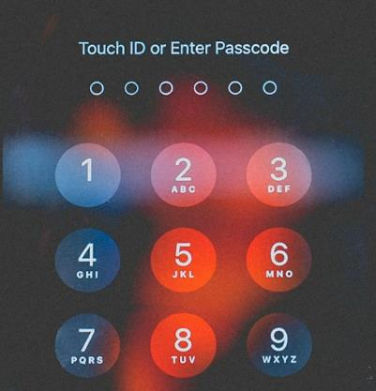
A simple decision rule
Pause
Take a moment before doing anything
Check
Do I recognise this?
Does it match my recent activity?
Verify
Open your banking app yourself
Use a trusted phone number

Slide 43

What a safe response looks like
A safe response means:
do not click unexpected links
do not share codes or personal details
end the call or message
check through your official banking app
contact the organisation directly
You choose how to respond

Slide 44

Where to get help in Ireland
You are not alone. If money is involved, contact your bank first, straight away.
Your bank
An Garda Siochana
FraudSMART.ie
Age Action
Call the number on the back of your card or use the official app. Available 24/7 for fraud.
Report at your local Garda station. 999 or 112 in an emergency. A report helps any refund claim.
Free advice on the latest scams. Use ScamSafe.ie to check if a link or website is genuine.
Specialist, patient support for seniors who have been targeted. They can help you report it.
Forward scam texts to 7726 (free). Forward scam calls by texting 7726 with the word Call and the number. For general advice, Citizens Information (citizensinformation.ie) can help too. There is no shame in being targeted.
Notes:
****LOCAL EXAMPLE****

Slide 45
Tips from younger family members
Simple habits that younger people use every day. Ask a grandchild to help you set these up.
Lock your phone
Keep apps updated
Use a PIN, fingerprint or face unlock. It keeps everything safe if your phone is lost.
Updates fix security gaps. Tap update when your phone asks, or set it to update on its own.
Do not reuse passwords
Pause before you tap
If one is stolen, the rest stay safe. A password manager remembers them for you.
Younger people scroll fast, but they stop and check links too. A few seconds saves trouble.

Slide 46
Key takeaways
You now know how to:
recognise safe and unsafe messages
understand how scams create pressure
check information before acting
respond safely and confidently
ask for help when needed
Digital finance can support independence and confidence.
Safe habits help you stay protected.
Pause. Check. Verify.

Slide 47


Congratulations, you have now completed Module 2…Continue to Module 3 - Social Engagement & Communication Tools
Follow our journey
www.ai4seniorsproject.eu

