Slide 1

AI for Daily Task Assistance
MODULE 4

Slide 2
Throughout this module and the AI for Seniors Course…If you come across any unfamiliar words or technical terms, you can find simple explanations in the AI for Seniors Glossary on our website at any time!
www.ai4seniorsproject.eu

Slide 3
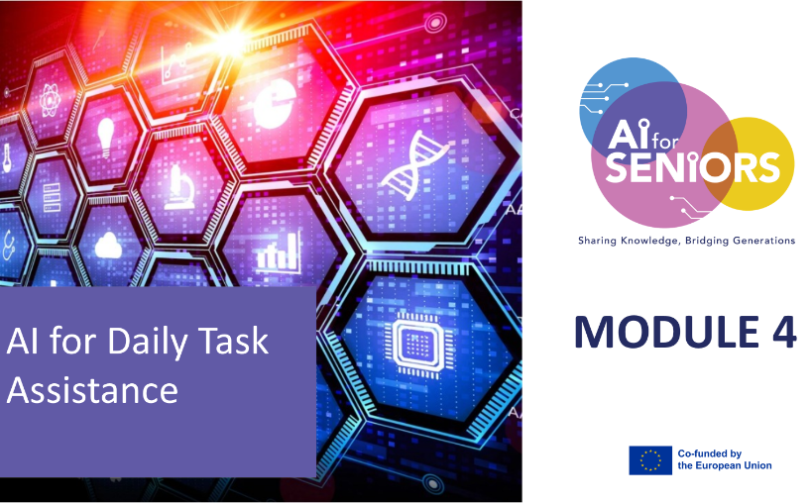
MODULE 4:
AI for Daily Task Assistance
LEARNING OUTCOMES
– Learners will be able to:
Use AI-supported tools for reminders, planning & everyday organisation
Understand what AI tools can and cannot do in daily life contexts
Make informed choices about reliance on AI while maintaining personal autonomy
Integrated critical elements: Limits of AI, transparency, informed decision-making

Slide 4


Contents
01
What digital assistants are & how they work
02
Using AI for reminders, lists, calendars & routines
03
Recommendation systems (shopping, travel, services)
04
Understanding AI limits & avoiding over-reliance
05
Making informed choices about AI tools

Slide 5

Introduction
Artificial Intelligence (AI) is becoming part of everyday life. Many phones, computers and smart devices now include tools that can help us organise tasks, remember appointments and find useful information.
In this module, we will explore how simple AI tools can support daily activities and make everyday routines easier.
You will learn how to use these tools safely, understand their limits, and make informed choices about when and how to rely on them.

Slide 6

01
WHAT DIGITAL ASSISTANTS ARE & HOW THEY WORK

Slide 7

What is a Digital Assistant?
A digital assistant is an AI tool that helps you with everyday tasks and supports your daily routine. They are designed to make life easier by reducing the need to remember, plan, and organise everything yourself. Some are voice-activated, some work through text or Apps, and some are connected to smart devices in your home.
Examples:
• Siri (Apple devices)
• Google Assistant (Android devices)
• Alexa (Amazon smart speakers)
• ChatGPT (text-based AI assistant)

Slide 8





How Can They Help in Daily Life?
Memory Support
Voice
control
Planning
Smart Home
Safety & Support
Reminders for medicines, appointments and daily tasks,
notes you can search later.
No typing needed, helpful for vision or mobility challenges, simple spoken commands.
Organise tasks automatically, give daily summaries (weather, plans), help reduce stress and confusion.
Automation, turn lights on/off, lock doors, control temperature.
Fall detection (e.g. smart watches), emergency alerts, automatic check-ins.

Slide 9


How AI assistants work
AI searches for information
You ask a question
AI understands the request
AI gives an answer

Slide 10

Case study: Anna
Anna (72) often forgot her doctor appointments.
Now she says:
"Hey Siri, remind me tomorrow at 10 am.“
Her phone reminds her automatically.
Results:
• fewer missed appointments
• less stress

Slide 11

Exercise
Write down 3 tasks you often forget
Question:
Could an AI assistant help you remember these?
Discuss in pairs.

Slide 12

02
USING AI, LISTS, CALENDARS FOR REMINDERS & ROUTINES

Slide 13

Using AI for Reminders & Routines
Using AI to Organise Your Day
AI tools can help you:
• Remember important things (birthdays, appointments, events)
• Plan your day (Meal planning, Medication, shopping lists)
• Stay organised
This topic shows how to use AI in real life.

Slide 14
Daily Life + AI Support - AI helps you stay organized!
Medicine
reminder
Calendar
Shopping list
Alarm

Slide 15

Using AI assistants for reminders
Watch this short demo: How to set reminders using Siri
After watching, try this exercise:
Practice setting:
A medicine reminder
A shopping list item
A calendar reminder
Example: "Hey Siri, remind me to call my daughter at 6 pm."
Or watch here on Youtube!
Notes:
https://www.youtube.com/watch?v=DN7FwObY_uQ

Slide 16


Read more on how to set up reminders here
How to Set Up Routines
Voice assistants can help organise daily activities by creating automatic routines.
Examples:
• morning reminders
• medicine schedules
• daily exercise prompts
• evening routines
Watch the example of how a routine can be set up using Alexa.
Or watch here on Youtube!

Slide 17

03
RECOMMENDATION SYSTEMS (SHOPPING, TRAVEL, SERVICES)

Slide 18

What Are Recommendations?
AI sometimes suggests things for you.
Examples:
• Movies on Netflix
• Products on Amazon
• Travel routes on Google Maps
• Restaurants nearby
These suggestions are called recommendation systems.

Slide 19
How Recommendations Work
your searches
Have you ever noticed a website recommending something to you? Was the suggestion helpful or not? The system tries to predict what you might like and shows suggestions such as products, movies, travel routes or restaurants. If you search for gardening tools, you may see similar product suggestions.
Remember:
AI suggestions are not always correct or suitable.
Always compare options and make your own decision.
your past choices
other users’ behaviour
suggests new things

Slide 20

Case study: Maria
Maria (70) searched for train tickets.
The website suggested:
• cheaper travel times
• nearby hotels
She compared options before choosing.
AI suggestions can help — but always compare!

Slide 21

Exercise: AI Recommendations
Think of a time when a website or app suggested something to you.
Examples: shopping online, movies or TV shows, travel routes, nearby services
Reflect: Was it useful? Did it match your needs? Did you follow it or choose something else?
While AI suggestions can be helpful, they should not be considered as decisions.

Slide 22

04
UNDERSTANDING AI LIMITS & AVOIDING OVER-RELIANCE

Slide 23

AI is Helpful but Not Perfect
AI tools can help us with everyday tasks, but they do not truly understand the world as humans do.
Sometimes AI may:
give incorrect answers
misunderstand a question
provide outdated information
give a prejudiced response
sound confident even when the answer is wrong
TIP: It is ok to ask your AI tool for evidence or proof for their response or information. Some tools give a confidence level, which can be a good indication of factual or non-factual information.

Slide 24
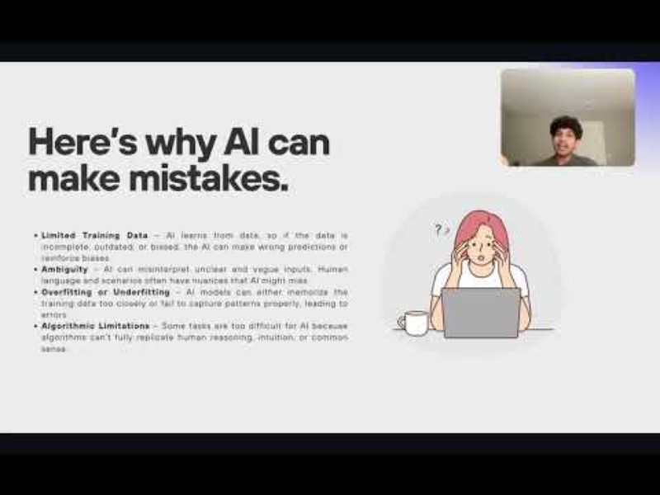

Can AI make mistakes?
AI should help you, not replace your decision making ability.
Good uses:
• Reminders
• Organisation
• Finding information
Be careful with:
• Health advice
• Financial decisions
Or watch the video on Youtube!
6. Here's why AI can make mistakes - YouTube
Notes:
https://www.youtube.com/watch?v=c2CBFSJyTdo

Slide 25
Scenario Case - John
John (74) asked an AI assistant about his medicine dosage.
The answer sounded correct, but he wasn’t sure.
He checked with a pharmacist — and the AI was wrong.
Lesson: AI can make mistakes, especially with health information.
Always check important advice with a trusted professional!

Slide 26

Exercise: When Should We Double-Check AI Information?
AI tools can be helpful, but there are situations where it is important to confirm the information with another source.
Think about everyday situations where relying only on AI could be risky.
Write down two examples where you should double-check information before making a decision.
After writing your examples, discuss them with someone.

Slide 27

05
MAKING INFORMED CHOICES ABOUT AI TOOLS

Slide 28

What Does Making an Informed Choice Mean?
AI tools can help with many everyday tasks, but it is important to choose tools carefully.
Before using an AI tool, ask yourself:
• What is this tool used for?
• Is the information reliable?
• Does it protect my personal data?
• Do I really need this tool?
Key idea:
Artificial intelligence should assist you, but you need to maintain control over it.

Slide 29
Tips for making informed choices about AI tools
Questions to Ask Before Using an AI Tool
When trying a new AI tool, think about:
• Who created the tool?
• What information does it collect?
• Is it free or paid?
• Is it recommended by trusted organisations?
Before installing an App, check:
• Reviews
• Privacy settings
• Official websites

Slide 30
Tips for making informed choices about AI tools
Some AI tools ask for personal data
For example:
• Your name
• Location
• Contacts
• Health information
Important tips:
• Only share necessary information
• Check privacy settings
• Avoid sharing sensitive data

Slide 31
Tips for making informed choices about AI tools
Comparing Different AI Tools
Different tools may offer similar services.
Before choosing a tool, compare:
• Ease of use
• Privacy settings
• Features
• Cost
Sometimes the simplest tool is the best one.

Slide 32

Tips from Young People About Using AI
Young people often use AI tools in their studies and daily life.
Here are some simple tips they share:
Use AI as a helper, not a decision maker
Always check important information
Protect your personal data
Try different tools and see what works best for you
Or watch the short video on YouTube that explains what AI is and how it works
Notes:
https://www.youtube.com/watch?v=ad79nYk2keg&t=2s

Slide 33
SCENARIO CASE - Tom
Tom (68) wanted to plan a train trip to visit his granddaughter. He tried a travel App that asked for personal information like email and location.
Feeling unsure, he compared another app. The second app provided the same travel information without asking for personal data. Tom chose the second app.
Key message: Choose tools that are easy to use, trustworthy, and respect your privacy.
Reflection: Have you ever stopped using an App because it asked for too much personal information?

Slide 34

Conclusion
AI tools can help with everyday tasks such as reminders, lists, calendars and planning daily routines.
Digital assistants (like Siri, Alexa or Google Assistant) can make daily life easier by helping to organise information and tasks.
Recommendation systems can suggest useful products, services or travel options, but they do not always know what is best for you.
AI tools can sometimes make mistakes or give incorrect information, so it is important to double-check important details.

Slide 35
Conclusion
Always use AI as an assistant, not as a decision maker.
Protect your personal information and be careful about sharing sensitive data with Apps or online tools.
When choosing AI tools, compare options and select ones that are safe, easy to use and trustworthy.
AI can support independence and confidence in everyday life when it is used carefully and thoughtfully.

Slide 36

Congratulations you have just completed Module 4, keep going on your learning journey…Module 5 discusses AI in Health Tracking & Well-being Support
Follow our journey
www.ai4seniorsproject.eu

