Slide 1
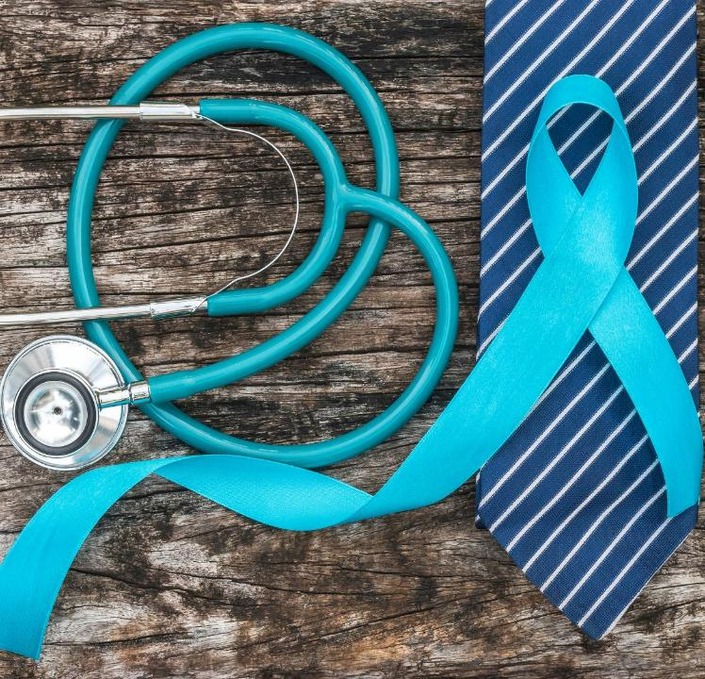
Health Tracking & Well-being Support
MODULE 5

Slide 2

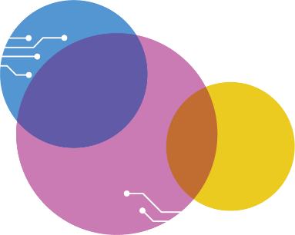
Contents
01
AI-based reminders & Activity Tracking
02
Health Apps & wearable technologies
03
Data privacy & sensitivity of health information
04
Risks, limits & ethics of AI in health contexts
05
Knowing when to trust AI & when to seek professional advice

Slide 3
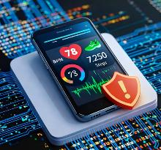
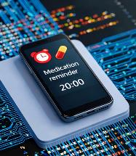

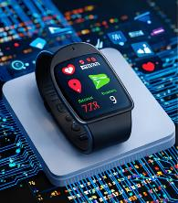

What Module 5 is about
Using the digital tools you already have can be a great help in everyday life. A phone, tablet or smartwatch, can help with small everyday tasks. When you use the tools, you already have, they can support you with small tasks, provide a quick overview, make it easier to keep track of habits, well-being, and thus create more peace of mind and clarity.
Digital tools can be used without the need for advanced technical knowledge. Once you get to know the key features, you can decide what’s useful and what to turn off. It’s not about being tech-savvy – it’s about making everyday life a little easier.

Slide 4
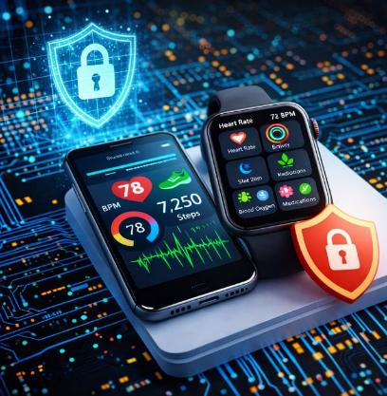
Module 5 - LEARNING OUTCOMES
In this module, you will receive some guidance on dos and don’ts, highlighting smart actions to take and pitfalls to avoid.
This module will teach you how to:
Use digital tools for basic health organisation, reminders & activity tracking
Recognise the limitations and ethical considerations of AI in health contexts
Critically assess health-related info & know when professional advice is required.

Slide 5
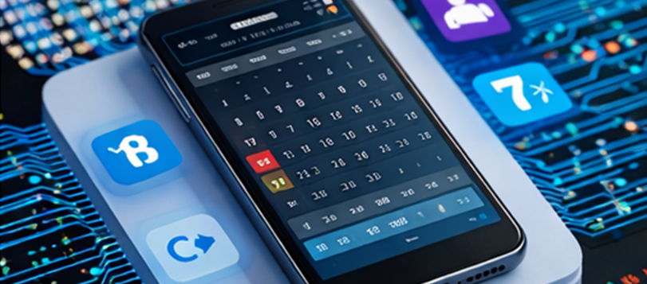
01
AI – ASSISTED REMINDERS & ACTIVITY TRACKING

Slide 6
Let’s Recap on what AI or Artificial Intelligence is…
AI is a technology that enables computers to learn from data and perform tasks that normally require human thought. (Click this Link to a short video explaining what AI is for further information)
This could include, for example, understanding language, recognising images, identifying patterns, suggesting solutions, or generating text, sound and images.
When it comes to reminders and activity tracking, AI can be used to understand the user’s habits and automatically customise reminders, so they come at the most relevant (or usual) times.
AI can also help record and analyse daily activities such as sleep, exercise and routines, as well as detect patterns that can bring more structure to everyday life. Although AI can be very helpful, it does not necessarily understand the world as a human does and can therefore make mistakes or be influenced by flawed data.

Slide 7
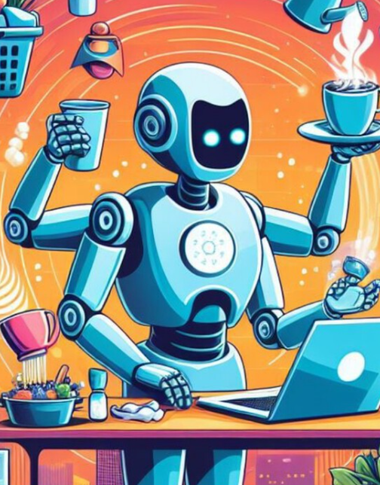
How AI reminders work
AI-powered reminders are integrated into various task management, calendar, and productivity applications. They are designed to automate scheduling, set smart notifications, and adapt to your workflow.
📱 Your device collects data (steps, time, routines)
↓
🤖 AI looks for patterns (e.g. you often walk at 10am)
↓
💡 AI suggests something (e.g. It’s time for a walk)
↓
🧠 YOU decide (accept / change / ignore)
AI suggests - it does NOT decide

Slide 8
How AI tracks activity
AI receives data from sensors in devices. Among other things, these sensors measure movement, steps, heart rate, sleep and location. AI then uses this data to identify patterns and provide reminders or assistance in everyday life.
AI collects data from small sensors built into devices such as:
mobile phones
smartwatches
fitness trackers
tablets and other devices
Examples of sensors
Motion sensor → detects whether you are walking, standing still or moving
Pedometer → counts your steps
Heart rate monitor → measures your heart rate / pulse
GPS → can track your location & therefore how far you walk or move
Sleep tracker → uses movement and heart rate to assess sleep
Microphone or voice recognition → can be used for reminders or commands

Slide 9
✔️ What AI Reminders can DO
AI-BASED REMINDERS
✖️ What they canNOT do
Helps you remember the little things in everyday life
It does not make diagnoses, and it cannot replace doctors
Suggests times based on your habits
It does not tell you what to do
Reminds you of what you’ve asked it to
It does not know whether a piece of advice is suitable for your health condition
Keeps track of steps, sleep and light activity
It cannot assess illness or dangerous symptoms
Gives you a quick overview – like a digital watch with extra support
It does not know how you are feeling

Slide 10
An AI reminder isn’t magic. As mentioned in Module 1, it simply looks for patterns in your habits -such as when you usually go for a walk or take your medication – and makes suggestions at these times.
Avoiding over-reliance on AI tools
While it's helpful to use reminders as support, avoid relying on them too heavily. Use them to assist you, but remember that your own routines and decisions should always take precedence.

Slide 11
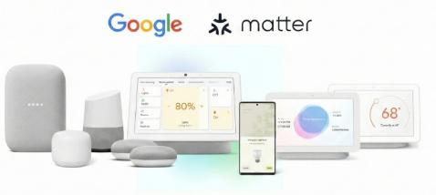
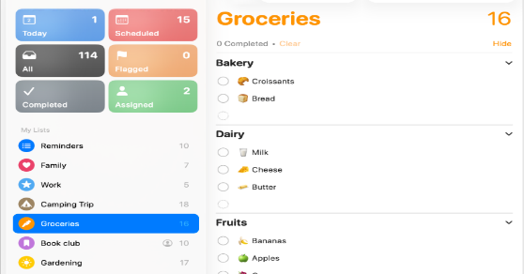
Some examples of Apps
Google Assistant is a voice-controlled App developed by Google. It acts as an intelligent ‘personal assistant’ on mobile devices, smart speakers and other smart products. The App
uses artificial intelligence to perform tasks, answer questions and control smart devices
via natural speech or text commands.
Apple Reminders is a to-do list and reminder App developed by Apple Inc. It is built into iOS, iPadOS, macOS and watchOS. It helps users organise personal
and work-related tasks using lists, reminders and automatic notifications.
Link to Google Assistant
Link to Apple Reminders

Slide 12
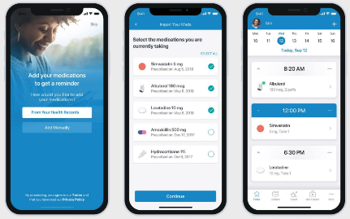
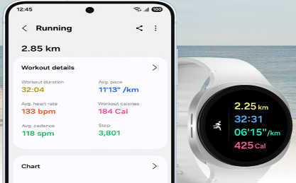
Some examples of Apps
Samsung Health is a mobile App for health tracking. The App collects data on physical activity, sleep, nutrition (if you log, what you eat) and mental habits. It is designed to help you maintain a balanced lifestyle. Among other things, it works in combination with wearables such as the Galaxy Watch and Galaxy Ring.
Medisafe (the Medisafe medication reminder App) is a mobile App for iOS (iPhone) and Android that helps users remember to take
their medication and keep track of their treatment. It can be used as a personal pill reminder and medication management platform.
Link to Medisafe
Link to Samsung Health

Slide 13
Reminders: Tips on safety, balance and general use
🤝 Human
tip
🌿 Balance tip
🚦 Safety
tip
You’re smarter than
the technology.
AI can help you with small practical things.
But you know best how you’re feeling.
Use AI as a support, not as the truth.
Use reminder devices or Apps in small doses.
If you’re getting too many reminders, turn some of them off.
Find the amount that brings peace — not stress.
Stop and think
if something seems wrong.
If AI suggests something that seems dramatic or unexpected:
Stop and think
Evaluate the suggestion
Proceed or ignore it
Remember: A reminder should not cause alarm.
Title Three
Title Four

Slide 14
Tips on ethics and data
🛡️ Data
tip
⚖️ Ethics
tip
You’re always
in control; AI can only
make suggestions when you allow
it to access your data. You can turn things on or off at any time in your phone’s Settings. (Module 1)
Remember:
If an App asks for something you don’t understand →
select “Don’t allow”.
Only share what you’re comfortable with
Reminders don’t need your personal health information.
You don’t need to share your location or your contacts to use the feature.
Rule of thumb:
The less data you share, the
more control you have.
Title Three
Title Four

Slide 15
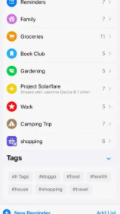
Step-by-step exercise
1️⃣ Open the App
📱 Reminders or Calendar
2️⃣ Tap “+” or “New reminder”
3️⃣ Write your reminder
✏️ “Take blood pressure medication at 10:00”
4️⃣ Choose a time
⏰ Pick a time that fits your daily routine
5️⃣ Press “Save”✅
6️⃣ Check your reminder
📋 Can you see it in your list?

Slide 16


Scenario Exercise 1
”Peter’s morning routine”
AI-assisted reminders and activity tracking
Peter, aged 76, has forgotten to take his blood pressure medication a couple of times.
His smartwatch starts suggesting a reminder at 9 am, because he is often in the kitchen at that time. Peter wonders: “How does the watch know that?”
He tries the reminder for a week and finds that it actually helps - but he turns it off at the weekend, when his routine is different.
Scenario questions:
What does AI do here, and what does it not do?
How can Peter manage his own reminder?
What would YOU do?
Find the answer here

Slide 17
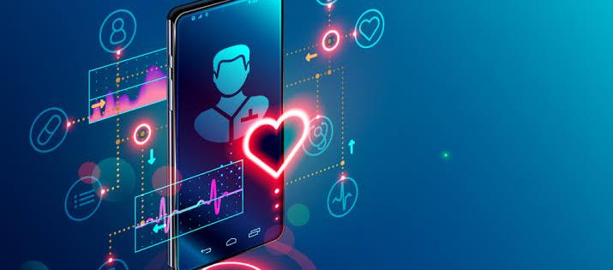
02
UNDERSTANDING HEALTH APPS & WEARABLE TECHNOLOGIES

Slide 18
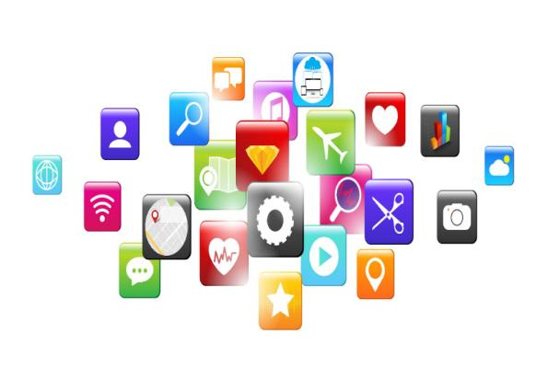
What is an App?
App stands for application.
An App is a small programme on your mobile, tablet or computer that allows you to perform tasks, for example:
Send messages
Read the news
Check the weather
Track your fitness or health
Receive reminders
Shop Online

Slide 19
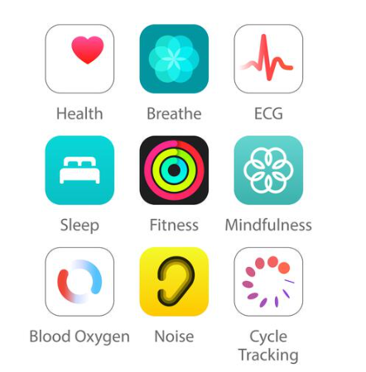
What is a Health App?
Health Apps are digital tools that collect simple information about your daily life, such as the number of steps you take, how long you sleep, or your heart rate.
They give you a clear and easy-to-understand overview of your activities, so you can spot patterns over time.
The app doesn’t interpret the figures for you, but presents them so that you can use them yourself to better understand your habits and your well-being.

Slide 20
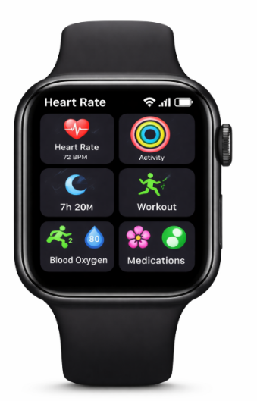
What is a wearable?
Wearables are small devices, typically a smartwatch or fitness tracker, that measure movement, heart rate and general activity throughout the day. They act as sensors that record data that a health App can display in an easy-to-read format.
Wearables give you access to real-time measurements, but they do not assess health or symptoms — they simply display what is being measured.

Slide 21
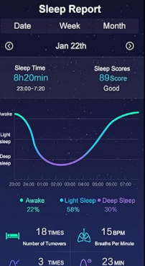
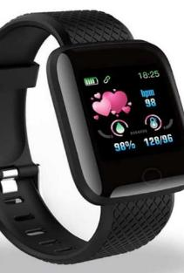
Using Health Apps?
⌚ What health Apps and wearables actually measure
Wearables measure simple things: heart rate, steps, sleep and activity. They provide a brief snapshot – not a diagnosis.
📊 What icons and graphs tell you
A heart means heart rate, a moon means sleep, and a footprint means steps. Graphs simply show when something happened, not whether it’s good or bad.
📱How to navigate a health App
Most Apps have a home screen where today’s figures are clearly displayed. You only need to know a few buttons: “Heart rate”, “Steps”, “Sleep”.
❓What you can use the information for
The figures help you spot small patterns: “I walked more yesterday” or “I slept less last night.” They’re a tool for reflection – not rules.
❗How to assess whether an App is trustworthy
A good App clearly states who is behind it and what the data is used for. You should be able to opt out of sharing data and still use the App.

Slide 22
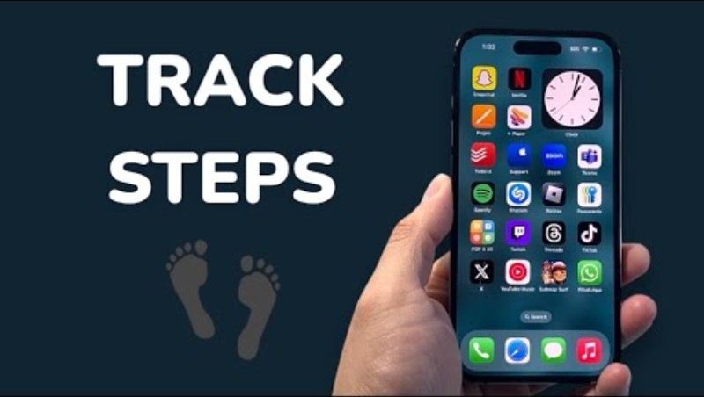
Using your phone as a pedometer
Watch these short videos to learn how to track your steps without a wearable – you just need to have your phone on you while walking / exercising.
How To Track Steps On Samsung Galaxy Without Watch!
How To Track Steps on iPhone Without Apple Watch - YouTube

Slide 23
Tips on ethics, data and function
🛡️
Data tip
🔒 Functional tip
🌱 Ethics tip
🤝
Human tip
You decide which sensors and data you want to share. Wearables work perfectly well even if you turn a lot of features off.
If a data reading looks unusual, it’s often due to movement, a loose watch or a technical fault – not a health issue.
Data from wearables is private. Only share it with Apps or people you trust
The number isn’t a verdict. Use it as inspiration – not a judgement.

Slide 24
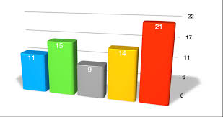

Scenario Exercise 2
Ella and the step counter
Understanding health Apps & wearable technologies
Ella, aged 74, opens her health App for the first time in ages. She sees 4,200 steps for the day and a graph showing high activity in the middle of the afternoon.
She thinks: “Oh yes, that was when I was out shopping.”
She becomes curious and checks her sleep stats, and discovers that the App only tracked her sleep for half the night, because the watch was loose.
Scenario questions:
What do the figures tell Ella — and what do
they not tell her?
How can she use this as inspiration rather than judgment?
Find the answer here

Slide 25
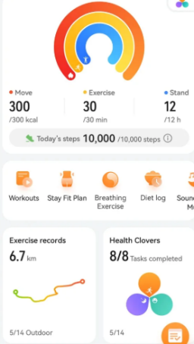
Step-by-step exercise
1️⃣ Open your Health App 📱
2️⃣ Find:
👣 Steps
❤️ Heart rate
🌙 Sleep
3️⃣ Tap one of them
4️⃣ Ask yourself:
👉 When was this measured?
👉 Does it match your day?
5️⃣ Say out loud:
“This is information – not a diagnosis”

Slide 26
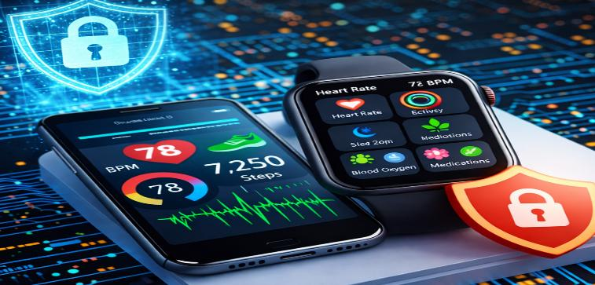
03
DATA PRIVACY & SENSITIVITY OF HEALTH INFORMATION

Slide 27
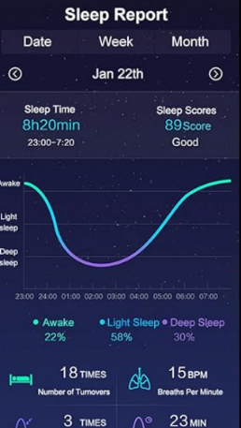
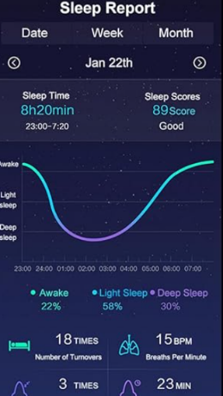
What is sensitive health data?
Sensitive health data is information that reveals details about your body, your habits or your health.
This could include step counts, sleep duration, heart rate readings or medication information.
This data must be handled with care, as it can reveal details about your lifestyle and well-being.
You ALWAYS have the right to choose who can see it.

Slide 28
Trustworthiness of Apps
Good signs (more trustworthy)
You know who made the App
It explains how your data is used
You can turn things OFF
It works without giving too much data
It does NOT make medical claims
Warning signs (be careful)
Asks for too much information
Uses dramatic language
(“High risk”, “Danger”)
Pushes you to act quickly
You don’t know who made it
It tries to replace a doctor
Apps you can trust:
Apple health
Google Fit

Slide 29
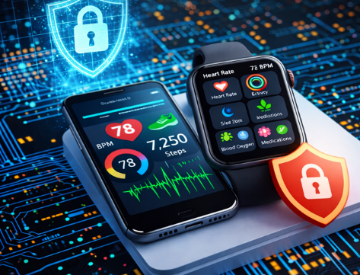
Why is Privacy Important in Health Apps?
Apps and wearables collect small amounts of data every time you use them.
This makes them useful – but it also means you need to keep track of who has access and what the data is used for.
As mentioned in Module 1, Privacy is about control: you need to be able to view, adjust and restrict access according to your own needs.

Slide 30
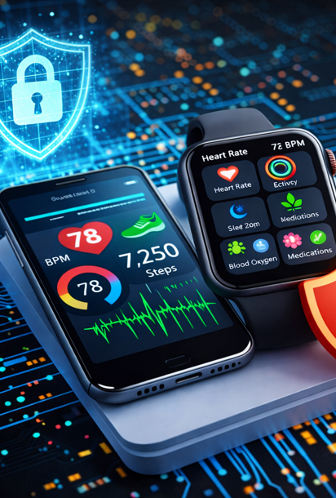
What health Apps & wearables should DO
Ask for permissions, so you can choose whether to share
Show which data they use (such as steps or heart rate)
Allows you to turn sharing on and off
Stores data locally or in the cloud, depending on your choice
Lets you change privacy settings at any time
️ What they DO NOT do
They must not share your health data without consent
They do not know who you are as a person – only your numbers
They do not read your messages or notes
They do not automatically grant others access
They do not assess your health based on your data

Slide 31

Tips on Ethics, Data and Security
🛡️ Data tip
🔒 Security tip
Only grant Apps access to exactly what they need. For example, a step counter doesn’t need access to your photos or contacts.
Check your “Permissions” a couple of times a year. Some Apps gain additional permissions after updates.
⚖️ Ethics tip
📍 Location tip
It’s ethical for Apps to tell you what they use your data for. If anything is unclear, it’s perfectly fine to say no.
Many wearables want to know your location. Turn this off unless you’re using features such as route tracking.

Slide 32

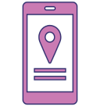

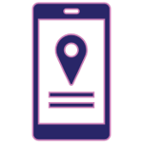

Scenario Exercise 3
“John receives a pop-up”
Data privacy & sensitivity of health information
John, aged 78, receives a message from an App:
“We would like to use your health data to improve your experience.”
He doesn’t know whether to say yes or no.
He goes into Settings → Permissions and discovers that the App also had access to his location, even though he never uses that feature. He turns it off and selects “Don’t share” on the new request. The App still works perfectly fine.
Scenario questions:
- Which data is “necessary”, and which is just
“nice to have” for Apps?
- How can John tell if sharing feels safe?
Find the answer here

Slide 33
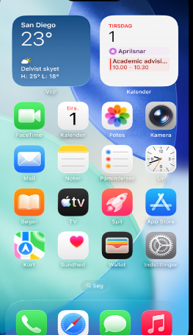

Step-by-step exercise
1️⃣ Go to Settings ⚙️
2️⃣ Find “Apps” or “Privacy”
3️⃣ Select a health App
4️⃣ Look at permissions:
📍 Location
📷 Photos
👤 Contacts
5️⃣ Ask yourself:
👉 Does this App really need this?
6️⃣ Turn OFF one permission you don’t need❌
More instructions available here

Slide 34

04
RISKS, LIMITS & ETHICS OF AI IN HEALTH CONTEXTS

Slide 35

AI can measure, but it cannot understand
AI works by identifying patterns. For example, it notices that you took fewer steps yesterday, or that your heart rate rose for a few minutes. This can be useful as a gentle reminder in your daily life, a way to keep track of your rhythms and habits without having to do it manually.
Although AI can detect changes, it cannot know why.
It doesn’t know if your heart rate went up because you were climbing stairs, got startled, laughed, slept poorly, or your watch was loose. It can only see the number itself, not the context in which it occurs.
Understanding, assessment, and diagnosis always lie with people—with you and with healthcare professionals.
AI is a thermometer, not a doctor: it shows something, but it doesn’t assess anything.

Slide 36
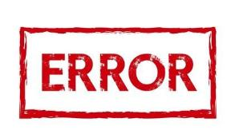
Why AI sometimes gets it wrong
AI bases its suggestions on previous readings and patterns, which means the system sometimes misinterprets the situation. If the reading is inaccurate because…
You’ve moved your arm, because the light is hitting the sensor at the wrong angle, or because the battery is low - the AI may give advice that doesn’t reflect reality. This doesn’t mean there’s anything wrong with you. - It just means the technology isn’t perfect.
Most health Apps are designed for everyday use - not for medical diagnosis. They can give you an idea of what your day looks like, but they can’t tell you if something is medically serious.
When AI gets it wrong, it is therefore not a sign of danger, but a signal that technology has limitations. This is completely normal - and something everyone needs to learn to recognise, so that AI can be used safely and with relaxed confidence.

Slide 37
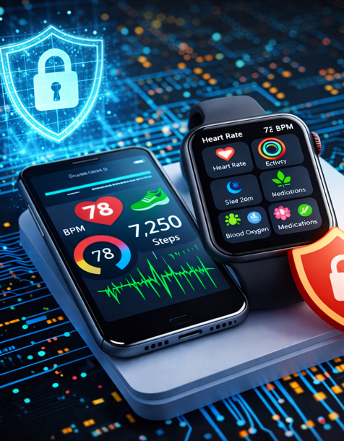
✔️ What AI can do
Analyse patterns in numbers
Suggest general habits (e.g. “go for a walk”)
Track changes over time
Alert you to unexpected readings
Help you make sense of your data
✖️ What AI CANNOT do
Make a clinical diagnosis or assess an illness
Understand your body or your life situation
Replace a healthcare professional
Predict future health problems
Determine what is normal for you

Slide 38
Tips on ethics, data and security
⚠️ Safety tip
🔒
Data tip
📌 Ethics tip
🧩
Helpful
tips
Never take serious health advice from an App. If you feel unsure or worried → contact a professional.
AI features often
use your metrics to learn. Make sure you only share data you’re comfortable sharing, and check who’s
getting it.
If an App
confuses you with dramatic statements or figures, stop and think.
The technology can misinterpret situations — it doesn’t mean
you’re wrong.
AI systems
can seem very
confident, but they lack human judgement. Use the systems for support —not for decision-
making.

Slide 39

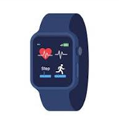
Scenario Exercise 4
The watch says ‘Possible stress’
Risks, limits & ethics of AI in health contexts
During an afternoon coffee break, 79-year-old Anna sees a message on her watch:
“Your heart rate is elevated. Possible stress.”
Anna is unsure but checks again after five minutes - her heart rate is normal.
She realises she had just walked quickly up the stairs.
She now understands: AI only sees the number, not the situation.
Scenario questions:
- Why was the AI wrong here?
- What can Anna do to assess the message calmly?
Find the answer here

Slide 40
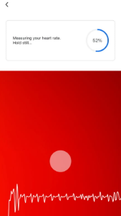
Step-by-step exercise
You read this message on your device:
“Your heart rate is high”
Now ask:
1️⃣What did I just do?
Walk - run – sitting still
2️⃣Could there be another explanation?
3️⃣Do I feel unwell?
Decision:
Ignore / check again / act

Slide 41
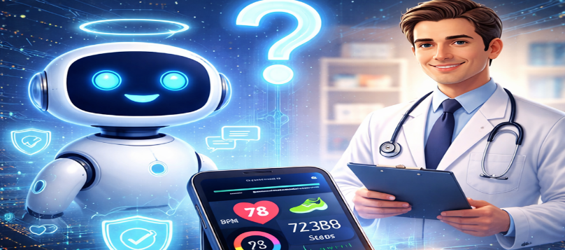
05
KNOWING WHEN TO TRUST AI & WHEN TO SEEK PROFESSIONAL ADVICE

Slide 42
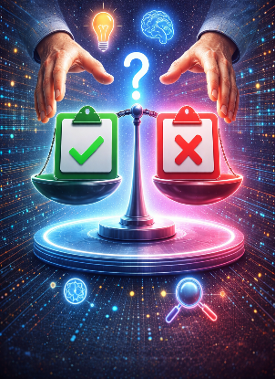
Decisions require human judgement
When you receive a message from an App, it can seem very authoritative: “Your heart rate is high.” “You slept poorly.” “You were less active today.”
But such messages are based on algorithms, not on medical knowledge or
human judgement. They are not dangerous — just automated.
It’s perfectly natural to feel doubtful if an App says something unexpected.
Doubt should always lead to calm reflection, not panic.
AI isn’t designed to detect illness or emergencies — it’s designed to
support your daily life.
When it comes to health, symptoms or concerns, a healthcare
professional must be involved.
AI provides data
People provide reassurance

Slide 43
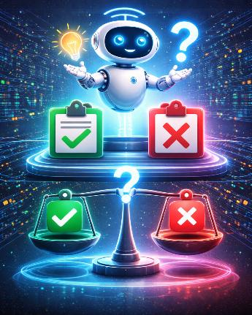
When can you trust AI, and when shouldn't you trust AI
✔️ When you can trust AI
🟢 General advice
“Go for a walk”
“Drink water”
“Take a break”
🟢 Data overview
Step count
Average heart rate
Sleep duration
🟢 Daily patterns
Morning activity
Less movement at the weekend
🟢 Simple reminders
Medication, Appointments, exercise
✖️ When you should NOT trust AI
🔴 Diagnoses
”You are at high risk of illness”
🔴 Alarming messages
“Dangerously high heart rate” without a medical monitor
🔴 Personal health assessments
“You are stressed”, “You are ill”
🔴 Suggestions that cause anxiety
If you become anxious → seek human advice
🔴 When in doubt
Doubt = contact a professional

Slide 44
Ethics, Data and Security Tips
⚕️ Safety tip
🧭 Ethics tip
🔍 Data tip
🫰 Security tip
If a piece of advice concerns your health, symptoms or something serious → contact a healthcare professional.
AI should never be the sole basis for a health decision
AI may suggest, but must never pressure you.
If an App makes you feel you must do something, turn off the notifications.
If an App gives health advice, look for the text:
“This is not a medical device.”
It is often written in small print in the App.
If a reading looks odd:
Take another measurement
Check the device is fitted correctly
Often, the error is
technical — not health-related.

Slide 45
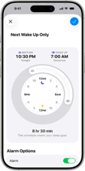
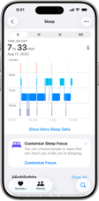
Scenario Exercise 5
The sleep report that worries David
Knowing when to trust AI & when to seek advice
David, aged 75, receives a notification from his App: “You slept poorly last night. Risk of tiredness all day.” However, he feels perfectly fine. He thinks: Should I take this seriously?
He uses the 1-2-3 rule:
1. General advice? — No.
2. Health-related? — Yes, but harmless.
3. Critical? — No.
He chooses to ignore it and contact his doctor only if he experiences symptoms — not because an App suggested it.
Learner questions:
When does it make sense to act on AI advice?
When is consulting a professional the right course of action?
Find the answer here

Slide 46
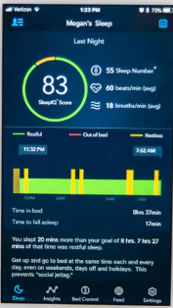
Step-by-step exercise
Read:
“You slept poorly”
Ask:
1️⃣ Is this general advice?
2️⃣ Do I feel unwell?
3️⃣ Am I worried?
👉 If YES → talk to a person👩‍⚕️
👉 If NO → ignore it✔️

Slide 47
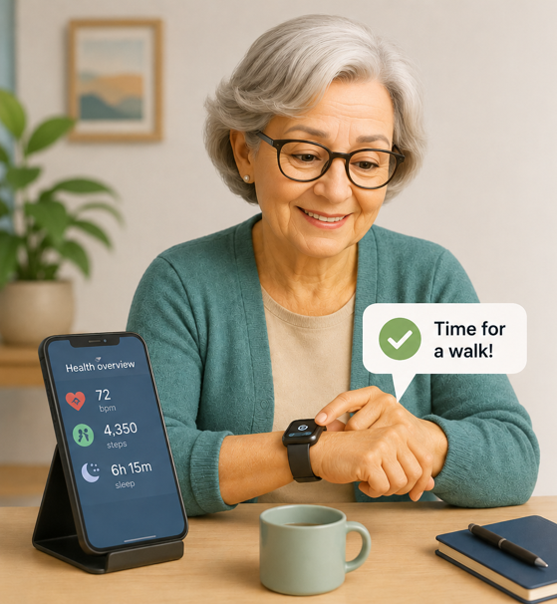
When can I trust AI?
AI is good at helping with everyday tasks when the
consequences of mistakes are minor.
Examples
✅ Reminders for medication or appointments
✅ Overview of steps, sleep, and activity
✅ General suggestions such as:
  “Take a break”
  “Drink water”
  “Go for a walk”
✅ Detecting patterns in daily life
Remember:
AI provides information—you make the decision.
📱 Data → 🤖 AI analyzes → 💡 Suggestions → 🧠 You decide

Slide 48
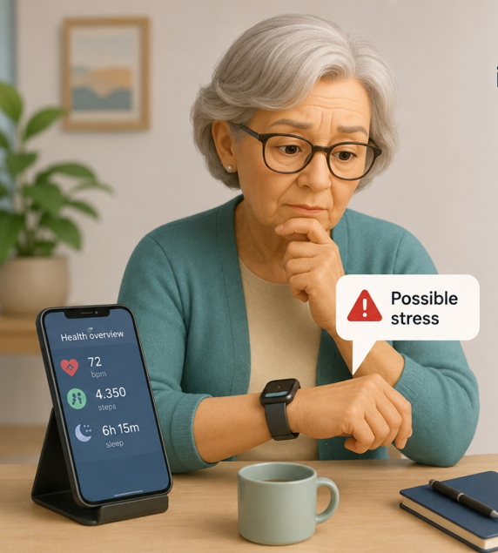
When should I not solely rely on AI?
The more serious the consequences of a mistake could
be, the less you should rely solely on AI.
Be extra critical when AI:
❌ Assesses illness or symptoms
❌ Sends alarming messages
❌ Says you are sick, stressed, or in danger
❌ Makes you feel worried or uncertain
Use 3 questions
Is it just a reminder or general advice?
Is it about my health or symptoms?
Could there be serious consequences if the AI is wrong?
If the answer is yes to question 2 or 3:
👩‍⚕️ Talk to a healthcare professional
AI can measure—but humans must interpret and decide.

Slide 49
Golden rules
You decide – not the App
AI helps – it does not decide
Data shows – it does not explain
When in doubt → talk to a person

Slide 50
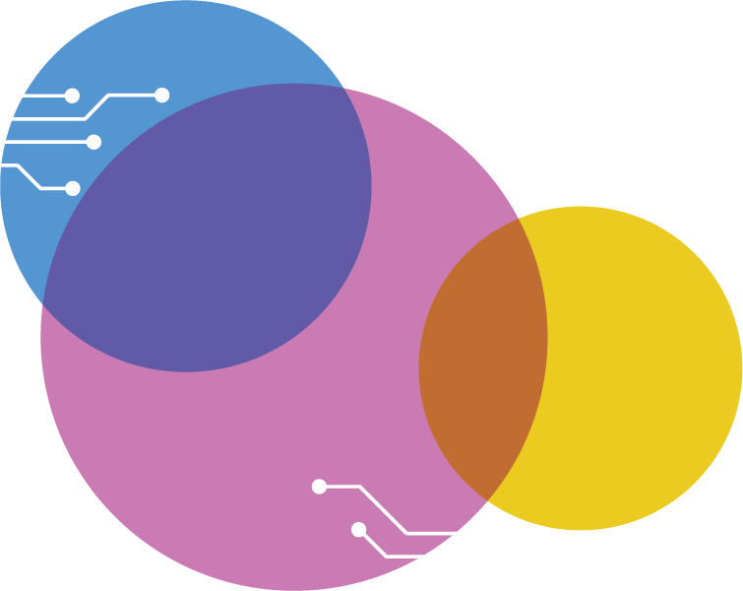
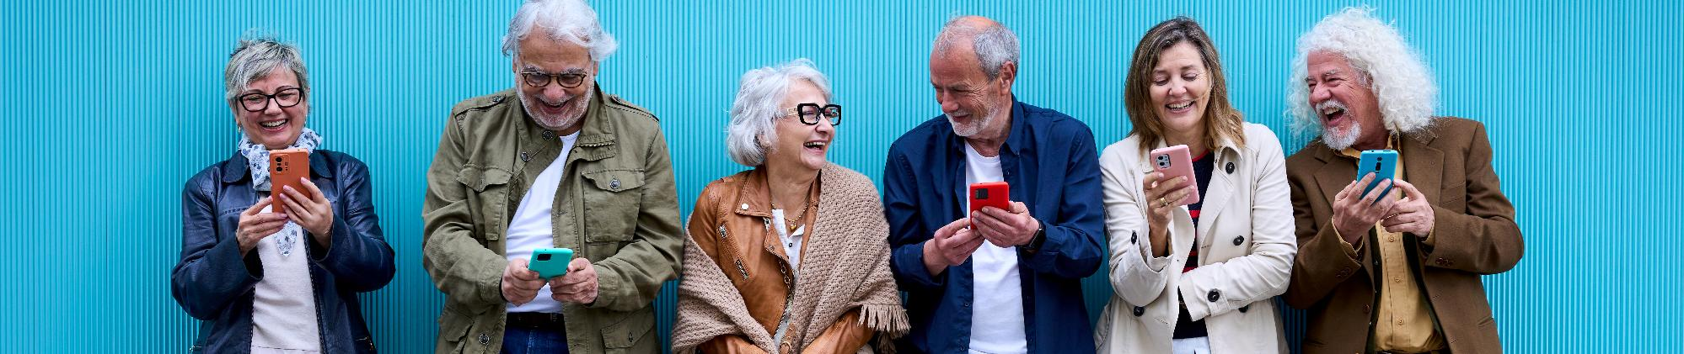
Congratulations, you have just completed the entire AI for Seniors Training Course. Remember to download the Digital Learner Guide to support you in your Daily use of AI tools
Follow our journey
www.ai4seniorsproject.eu

Slide 51
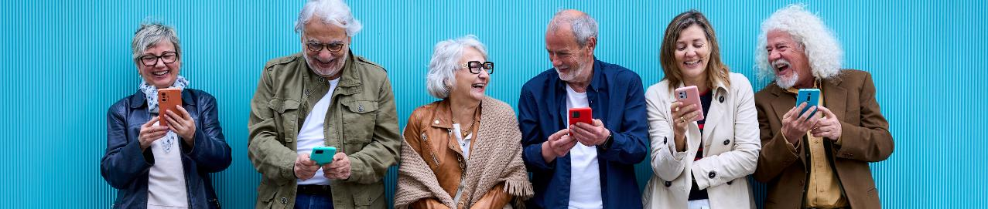
Follow our journey
www.ai4seniorsproject.eu

